Slide 1
Planning Support Guide for Landowners and Businesses

Slide 2
Table of contents
Chapter 1 – Planning rules and preparing an application
Explainers can be included in here to highlight key items that local applicants and community need to better understand. Tailor these to each council’s circumstances or remove if not needed.
Page X
Chapter 2 – Zones
Explainers can be included in here to highlight key items that local applicants and community need to better understand. Tailor these to each council’s circumstances or remove if not needed.
Page X
Chapter 3 – Overlays
Explainers can be included in here to highlight key items that local applicants and community need to better understand. Tailor these to each council’s circumstances or remove if not needed.
Page X
Chapter 4 – Glossary and support materials
Explainers can be included in here to highlight key items that local applicants and community need to better understand. Tailor these to each council’s circumstances or remove if not needed.
Page X

Slide 3
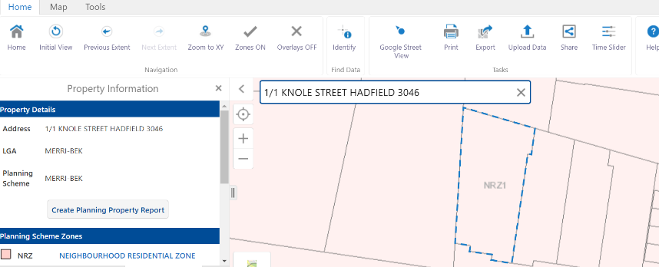
How to use this guide
So, you’re interested in learning more about how the planning rules might impact your property, house or business-idea?
Use this guide to get you prepared to submit a high-quality planning application. Or, if it seems confusing and difficult, that’s okay – now could be a good time to speak to professionals who will support you in helping your idea become reality!
Where do I start?
This guide includes four chapters focused on understanding planning rules, introducing zones, overlays and demystifying planning language. As mentioned in Chapter 1, the first thing to do is create a Planning Property Report from VicPlan: https://mapshare.vic.gov.au/vicplan/
This creates a unique Planning Property Report that outlines the zones and overlays applying to your property (although there’s lots of other information in there too).
Once you’ve found the zones (Chapter 2) and overlays (Chapter 3) in the report, find the right pages in this guide. This will help understand what might need a planning permit, what might be allowed without a planning permit and what might not be allowed at all. This guide will also offer key information you need to know, if a planning application is needed.
You’ll have questions – our planning department is the best place to confirm anything that is unclear. Refer to our website <insert link> as we’ve got answers to the most common planning questions there. If you still have questions, give us a call during business hours.
If you’re still struggling, you can also contact a professional. These people are usually experienced in planning matters and should be able to help realise your dreams! A Google search looking for local ‘town planners’, ‘architects’ or ‘designers’ is a good place to start!
Good luck on your planning journey and we look forward to working with you!

Slide 4
Chapter 1 Planning rules and preparing an application
Tips, support and the process

Slide 5
Introduction
Understanding planning rules and preparing permit applications can be challenging. Knowing key information and how to prepare documents may be the first step to success.
Our planning and development experts work to ensure that our community's built environment meets the needs of the community and aligns with our strategic priorities. This is guided by the [Insert council name] planning policies and controls that apply to your property.
We will assess your proposal against the planning policies and controls to make sure it is the right outcome for the site. To do this, we need you to provide the right information when you apply for your planning permit. A complete and high-quality application will also save you time during the application process.
This guide has been written for people who are not familiar with the planning system, would like to understand the controls on their land and may be thinking about submitting a planning application.
What is in this guide
Chapter one of this document will help you:
Identify the planning controls and policies that apply to your property
Identify what information you need to include in your application (you may need professionals to prepare some of the specialist documents)
Identify who you need to talk to and when
Chapter two and three will help you understand the planning controls that might apply to your property, what it might say for your proposal, and what information you need to include in your application.
Planning can use technical and confusing language. Use Chapter four to this guide to demystify planning terminology and better understand how plans or other documents might need to look.

Slide 6
What is the planning scheme?
A planning scheme is a legal document that sets out objectives and policies for a local government area. The planning scheme regulates how land is used and developed. To be approved, a planning permit application must be consistent with the local planning scheme.
The most common parts of the planning scheme to be aware of are summarised below. Refer to Using Victoria’s Planning System (DELWP, 2022) for more detailed information.
Planning Policy Framework & Municipal Planning Strategy
Planning policies (known as the Planning Policy Framework & Municipal Planning Strategy in the planning scheme) contain broad strategies for the municipality. These policies can apply to the entire state, a smaller region, or the local government area.
Planning policies manage growth and development in Victoria and are applied at a local level in decisions on planning applications. The policies can apply to geographic areas (e.g., parts of a municipality) or by land use themes (e.g., residential, commercial, farming).
Zones
All land in Victoria has a zone. The zone identifies purposes of the land and is generally applied to broader areas to achieve a particular land use focus (e.g., residential, commercial, and industrial).
Each zone identifies if a land use:
Does not require a planning permit in the zone
Requires a planning permit in the zone
Is prohibited in the zone
The zone also identifies if a planning permit is required to construct a building or make other changes to the land.
The zone lists information that must be included in an application and outlines matters that council considers when making a planning decision.
Overlays
Your site may be subject to an overlay. Not every site has an overlay, and some sites can be subject to multiple overlays. An overlay is applied if the land has a special feature such as a heritage building, significant vegetation or flood risk.
The overlay indicates if a planning permit is required to construct a building or make other changes to the land. Some overlays also need a planning permit for a new land use. An overlay may list information that must be included in an application.

Slide 7
What is the planning scheme?
Particular provisions
Particular provisions relate to specific types of land use or development. The most commonly-used provisions are liquor licence, signs and car parking. These provisions identify if a planning permit is required and what needs to be included in the application.
Schedules
Zones and overlays generally have schedules that include additional information or requirements more specific to the local area.
The schedule may identify if a permit is required, what information needs to be included in an application, and matters council must consider when making a planning decision.
Important note
If a planning permit is not triggered under the zone, you may need a planning permit under an overlay or particular provision. It is important to check all planning controls and provisions that apply to identify if you need a planning permit. Afterwards if you are not sure, speak with council's planning team.
Even if you don’t need a planning permit, you may still need other permits or approvals under different regulations (such as building permits, local law licences, etc). Check with council’s business concierge or other professionals before you start your activity or development.

Slide 8
What are my first steps?
How to find the information you need to work out if you might need a planning permit and start your planning permit application:
Step One
Visit VicPlan [insert link] to create a planning property report. The planning property report identifies the zones and overlays that apply to your site.
The zones and overlays will tell you:
What you can and can’t do on the site
If you need a planning permit
What information you need to include in an application
The guidelines council uses to make planning decisions
The information in this guide will help you understand the planning controls and permit requirements.
The information in chapter x will help you find the relevant policies and how it may apply to your site and proposed use.
Step Two
Review the [insert local government name] Planning Scheme [insert link] to identify any relevant policies and clauses that apply to your site and your idea.
This will also help you understand the information required for an application and what Council consider when making planning decisions.
Step Three
Download a certificate of title. A title is used to identify your site and any restrictions that impact use or development. The certificate of title includes:
Register Search Statement
Title plan
Any instruments identified as s173 agreements, covenants, encumbrances or easements
You do not need to order mortgage instruments
A step by step guide to obtaining a certificate of title can be found here [Insert link to Landata Video].

Slide 9
What are my first steps?
You can speak with council for advice if you should engage a consultant planner and other professionals.
Step Four
You may need to speak to some professionals to offer advice, prepare specialist documents and design plans.
This guide will help identify if there are any relevant referral authorities.
Step Five
In particularly circumstances, you may wish to contact referral authorities like the water authority or CFA. Contact council if you are not sure if you should speak to a referral authority.
[Insert any Council-specific comments around pre-application meetings processes and timings].
Step Six
Speak with council about your proposal before you start preparing your application. Council may recommend that you book in a pre-application meeting before you submit an application. In this meeting, Council can provide you with preliminary feedback on your proposal and what information you will need to include in your application.

Slide 10
What information do I need to include in my application?
Plans and documents
Different types of planning applications have unique requirements. This might include site plans, plans and elevations, town planning reports, and other technical reports.
This guide will help you identify the information you need to lodge based on the planning controls. It can also be helpful to speak with a consultant planner to make sure you have all the relevant information.
If all the required information is not lodged, this will result in delays, as council will need to request it formally.
Application form
Your application must include a completed planning permit application form. The form is available on council’s website [insert if relevant: or completed by using council’s submission portal].
You must provide details on the site address, the existing and proposed uses, and the estimated cost to develop (if relevant), and the landowner’s contact details. You must also state that the landowner has given their consent if the landowner is not the permit applicant.
Certificate of title
You must include a certificate of the title, which is used to identify your site and any restrictions that may impact development. The title must be less than three months old.
Your title must include:
Register Search Statement
Certificate of title
Any instruments identified as s173 agreements, covenants, encumbrances or easements.
Mortgage instruments are not needed.
A step-by-step guide to obtaining a certificate of title can be found here [insert link to Landata Video].
Fees
You must pay an application fee to council when lodging the application. Speak with council about the cost and how it can be paid.
Metropolitan Planning Levy
You may need to pay the Metropolitan Planning Levy (MPL) to the State Revenue Office if you propose to develop land in metropolitan Melbourne where the estimated cost of the development is more than the levy threshold.
The levy threshold was $1 million in 2015-16 and is adjusted by the Consumer Price Index on 1 July each year. Visit the State Revenue Office website [insert link] for the current levy threshold.
An MPL certificate is valid for 90 days after its issue date and must be included in your application.

Slide 11
Chapter 2 Zones
Purposes, permit applications and processes

Slide 12
Residential Zones
Clause 32 in local planning schemes
Page 13 – Low Density
Page 14 – Mixed Use
Page 15 – Township
Page 16 – Residential Growth
Page 17 – General
Page 18 – Neighbourhood

Slide 13
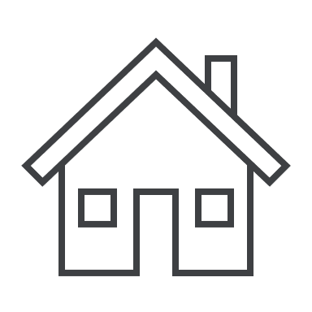
Low Density Residential Zone
What is the Low Density Residential Zone?
The Low Density Residential Zone (LDRZ) allows residential development at lower densities. These lots may not be connected to reticulated sewerage and require on-site wastewater treatment.
When is a planning permit usually required?
A permit is generally required to:
Use land for non-residential land uses
Build a second house
Subdivide land (check the schedule for minimum subdivision areas)
You may also need a planning permit to do other works, including building a large shed or making changes to an existing dwelling’s ground level. Review the LDRZ (insert link) for a full list of what needs a planning permit.
What may not need a planning permit?
In most instances, the following will not require a permit:
A single house with services connected.
Small and medium sized sheds.
Renovations, outdoor structures, fences and other minor things associated with a house.
Always check to see if any permits are triggered by an overlay or particular provision.
Is anything not allowed in the LDRZ?
Some agricultural uses, mining / quarrying, most industrial uses, cinemas, offices, nightclubs, some retailing, warehousing and brothels are not allowed in the LDRZ.
What do I need to include in my planning permit application?
If your application is for development then the following information will generally be required:
Site plans, showing key features of the site and adjoining properties – this includes a neighbourhood and site description, and design response
Elevation plans including floor levels, boundary setbacks and designs of the building
Floor plans, detailing setbacks from boundaries, areas of open space and proposed features
If the site requires wastewater to be treated on-site, an effluent disposal area must be shown and a land capability assessment may be needed
If your application is for a land use, then council generally need to know about things like traffic and vehicle movements, numbers of patrons, hours of operation, layout of the land use, any additional noise or smell impacts or other items.
Are there any specific requirements?
Many LDRZ lots do not have reticulated sewerage. Effluent disposal must be considered in these situations.

Slide 14
Mixed Use Zone
What is the Mixed Use Zone?
The Mixed Use Zone (MUZ) provides for a variety of residential, commercial and other uses which complements the surrounds. The MUZ also seeks to encourage housing at higher densities that is responsive to the surrounding character.
When is a planning permit usually required?
A permit is generally required for:
More ‘vibrant’ land uses including doggy day care, breweries, gyms and warehouses
New uses in larger buildings (over 250sqm)
Single houses on small lots
Two or more houses on any lot
New buildings for a land use that needs a permit
Subdivision
Check with council to see if a permit is needed before proceeding too far with an idea.
A permit may also be triggered by an overlay or particular provision.
What may not need a planning permit?
Some land uses may not need a permit but there may be limits on the area of the land can be used. A single house on a larger lot may not need a planning permit. Some smaller buildings for other land uses may also avoid needing a planning permit. Overlays may impact whether a permit is needed, so check closely.
Is anything not allowed in the MUZ?
Some agriculture, brothels, mining / quarrying and rubbish collection are not allowed.
What do I need to include in my planning permit application?
If your application is for new development then the following will generally be required:
Site plans, showing key features of the site and adjoining properties – this includes a neighbourhood and site description, and design response
Elevation plans with floor levels, boundary setbacks and designs of the building
Floor plans, detailing setbacks from boundaries, areas of open space and proposed features
If your application is for a land use, then council generally need to know about things like:
Traffic and vehicle movements
Numbers of patrons
Hours of operation
Layout of the land use
Any additional noise or smell impacts or other items
It can also be important to understand the land uses on surrounding properties.
Are there any specific requirements?
In almost all applications, a planning report should be submitted. Depending on where the land is, other consulting reports may be required including:
Traffic and car parking report
Tree investigations / arborist report
Landscape plan
Environmentally sensitive design report
Councils may have requirements for these reports, so speak to them before progressing too far.

Slide 15
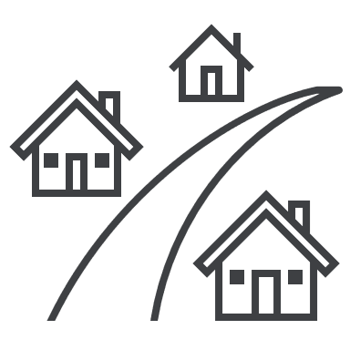
Township Zone
What is the Township Zone?
The Township Zone (TZ) supports a range of land uses for small Victorian towns. This is primarily for residential use but extends to the diversity of activities needed to support regional communities. Many TZ lots are absent of reticulated sewerage, requiring wastewater to be treated on-site.
When is a planning permit usually required?
A permit is generally required for:
Most non-residential land uses, including commercial, industrial and some community uses
New uses in larger buildings (over 250sqm)
Single houses on small lots
Two or more houses on any lot
New buildings for a land use that needs a permit
Subdivision
Check with council to see if a permit is needed before proceeding too far with an idea. A permit may also be triggered by an overlay or particular provision.
What may not need a planning permit?
In most instances, the following will not require a planning permit:
A new single house with services connected
Small- and medium-sized sheds
Renovations, outdoor structures, fences and other things used with a house.
Some new uses in existing buildings.
Always remember to check the overlays, as they might include a permit requirement.
Is anything not allowed in the TZ?
New houses without septic, water or power are not allowed. Also, some agriculture, brothels, saleyards, mining / quarrying are not allowed.
What do I need to include in my planning permit application?
If your application is for a new development then the following will generally be required:
Site plans, showing key features of the site and adjoining properties – this includes a neighbourhood and site description, and design response
Elevation plans including floor levels, boundary setbacks and designs of the building
Floor plans, detailing setbacks from boundaries, areas of open space and proposed features
If the site requires wastewater to be treated on-site, an effluent disposal area must be shown and a land capability assessment may be needed
If your application is for a land use, then council generally need to know about things like traffic and vehicle movements, numbers of patrons, hours of operation, layout of the land use, any additional noise or smell impacts or other items.
Are there any specific requirements?
Many TZ lots do not include reticulated sewerage – effluent disposal must be considered in these situations. This may require several smaller lots to allow a new house to be built.
Many TZ lots are within a bushfire prone area, which may affect the materials permitted in construction.

Slide 16
Residential Growth Zone
What is the Residential Growth Zone?
The Residential Growth Zone (RGZ) provides for housing at increased densities in places with good access to services and transport. The RGZ may include a suggested maximum height or other guidance. Many councils have allocated this land for apartment living and / or medium density housing.
When is a planning permit usually required?
Although apartment buildings and housing growth are encouraged, a permit is still required for:
Building two or more houses (or apartments)
Smaller lots also may need a permit for a single house or renovations
Use land for non-residential land uses
Subdivision
Check with your council for a new land use that is different to using the property for housing. A permit may also be triggered by an overlay or particular provision.
What may not need a planning permit?
In most instances, the following will not require a planning permit:
A single house on a larger lot
Renovations, outdoor structures, low fences and other minor things used with a house
Many residential land uses may not need a permit.
Is anything not allowed in the RGZ?
Most agricultural uses, bottle shops, mining / quarrying, most industrial uses, cinemas, offices, some retailing, nightclubs, warehousing and brothels are not allowed in the RGZ.
What do I need to include in my planning permit application?
Applications in the RGZ are often a priority for council, so it is important to be well prepared. It may be good to speak to a professional planner.
If the application is for development then the following will be required (although overlays may require other things to be prepared too):
Site plans, showing key features of the site and adjoining properties – this includes a neighbourhood and site description, and design response
Elevation plans including floor levels, boundary setbacks and designs of the building
Floor plans, detailing setbacks from boundaries, areas of open space and proposed features
If your application is for a land use, then council may need to know about things like:
Traffic movements and car parking layout
Number of patrons
Opening hours
Layout of the use
Any additional impacts to neighbours
Are there any specific requirements?
In almost all applications, a planning report should be submitted. Depending on the scale of development, many other consulting reports could be needed including:
Traffic and car parking report
Tree investigations / arborist report
Landscape plan
Environmentally sensitive design report
Councils have requirements for these reports, so chat to them before progressing too far.

Slide 17
General Residential Zone
What is the General Residential Zone?
The General Residential Zone (GRZ) is the most common residential zone. This zone encourages new development that respects local character while introducing a diversity of housing.
The GRZ has a mandatory three storey / 11 metre height limit for residential development.
When is a planning permit usually required?
Although the GRZ is a standard residential zone, a planning permit is required for:
Building two or more houses
A new house or renovations on smaller lots
New buildings for land uses that need a permit
Using land for most non-residential activities
Subdivision
Check with your council for a new land use that is different to using the property for housing. A permit may also be triggered by an overlay or particular provision.
What may not need a planning permit?
In most instances, the following will not require a planning permit:
A single house or renovations on a large lot
Outdoor structures, low fences and other minor things to do with a house
Some residential land uses
Is anything not allowed in the GRZ?
Most agricultural uses, mining / quarrying, most industrial uses, cinemas, offices, some retailing, warehousing and brothels are not allowed in the GRZ.
What do I need to include in my planning permit application?
If your application is for new housing or other development then the following is usually needed:
Site plans, showing key features of the site and adjoining properties – this includes a neighbourhood and site description, and design response
Elevation plans including floor levels, boundary setbacks and designs of the building
Floor plans, detailing setbacks from boundaries, areas of open space and proposed features
If your application is for a land use, then council may need to know about things like:
Traffic movements and car parking layout
Number of patrons
Opening hours
Layout of the use
Any additional impacts to neighbours
Are there any specific requirements?
In almost all applications, a planning report and other consulting reports should be submitted. The other reports could be:
Traffic and car parking report
Tree investigations / arborist report
Landscape plan
Environmentally sensitive design report
Councils have requirements for these reports, so chat to them before progressing too far.
Some GRZ lots are in a bushfire prone area, which affects the materials allowed for construction.

Slide 18
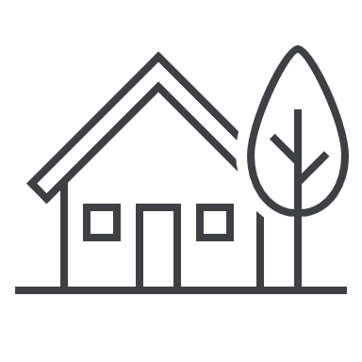
Neighbourhood Residential Zone (NRZ)
What is the Neighbourhood Residential Zone?
The Neighbourhood Residential Zone (NRZ) recognises areas that are mostly one- or two-storey residential in character. This zone manages an identified local character for new development.
The NRZ has a mandatory two storey / 9 metre height limit for new residential development.
When is a planning permit usually required?
The NRZ requires a planning permit for:
Building two or more houses
A new house or renovations on smaller lots
New buildings for land uses that need a permit
Using land for most non-residential activities
Subdivision
Check with your council for a new land use different to using the property for housing.
What may not need a planning permit?
In most instances, the following will not require a planning permit:
A single house or renovations on a large lot
Outdoor structures, low fences and other minor things to do with a house
Some residential land uses
Is anything not allowed in the NRZ?
Most agricultural uses, mining / quarrying, most industrial uses, cinemas, offices, some retailing, warehousing and brothels are not allowed in the NRZ.
What do I need to include in my planning permit application?
If your application is for new housing or other development then the following is usually needed:
Site plans, showing key features of the site and adjoining properties – this may also include a neighbourhood and site description, and design response
Elevation plans including floor levels, boundary setbacks and designs of the building
Floor plans, detailing setbacks from boundaries, areas of open space and proposed features
If your application is for a land use, then council may need to know about things like:
Traffic movements and car parking layout
Number of patrons
Opening hours
Layout of the use
Any additional impacts to neighbours
Are there any specific requirements?
In almost all applications, a planning report and other consulting reports should be submitted. The other reports could be:
Traffic and car parking report
Tree investigations / arborist report
Landscape plan
Environmentally sensitive design report
Councils have requirements for these reports, so chat to them before progressing too far.
Some NRZ lots are in a bushfire prone area, which affects the materials allowed for construction.

Slide 19
Schedule X to the XXZ
Use this template to develop local content to better explain particular schedules, especially those that might be common or difficult for home- and business-owner applicants to understand. This template can be replicated numerous times to meet council’s needs.
Relevant icon here
XXXXX City / Shire / Rural City Council
To what areas does schedule X to the XXZ apply?
This schedule – known as the XXZX – applies to the…
Use this section to briefly explain what this area is called and anything that the general public might need to know about the schedule.
What are the neighbourhood character objectives for the XXZX?
Use this section to elaborate on the neighbourhood character objectives. We recommend two or three sentences to explain the key elements of the objectives. Always use plain English over technical planning language.
Are there any specific differences when assessing applications in the XXZX?
This section might need two paragraphs to explain any variations to Clause 54 / 55 standards, fence heights or mandatory building heights.
This doesn’t need to be specific but should elaborate on what a homeowner or interested party might want to know. For example, “fence heights are preferred to be under 1.2 metres high in local streets” or “the XXZX prefers buildings to be setback from site boundaries – there is a calculation depending on how high the wall is”.
Are there any specific application requirements in the XXZX?
This section should outline the specific application requirements and when they might apply. We recommend two or three sentences to explain key pieces of information that a homeowner or interested party might want to know.
Are there any specific decision guidelines in the XXZX?
This section should outline the specific decision guidelines and the implications for any planning applications.
We recommend two paragraphs of two to four sentences to explain key pieces of information that a homeowner or interested party might want to know. Always use plain English over technical planning language

Slide 20
Industrial Zones
Clause 33 in local planning schemes
Page 21 – Industrial 1
Page 22 – Industrial 2
Page 23 – Industrial 3

Slide 21
Industrial 1 Zone
What is the Industrial 1 Zone?
The Industrial 1 Zone (I1Z) supports manufacturing, storage and distribution of goods and other light industrial uses. These uses should not negatively impact the safety or amenity of nearby non-industrial land.
When is a planning permit usually required?
The following uses and developments may require a permit:
Most new buildings (although some of these qualify for the fast-track VicSmart assessment process)
Using land for industrial activities that do not meet amenity protection guidelines
Subdivision
Check with your council for a new land use that is different to using the property for an industrial activity, particularly if the site has been vacant for some time. A permit may also be triggered by an overlay or particular provision.
What may not need a planning permit?
The following actions may not require a permit:
Most land uses associated with manufacturing or warehousing, provided they meet guidelines for amenity protection
Internal alterations to buildings
Installation of minor supporting infrastructure
Is anything not allowed in the I1Z?
Most residential uses, cinemas, hospitals, most agriculture and some shops are not allowed in the I1Z.
What do I need to include in my planning permit application?
If your application is for a new building, an extension to an existing one or other development then the following will generally be required:
Site plans, showing key features of the site and adjoining properties – this may also include consideration of the surrounding area, and a design response
Elevation plans including floor levels, boundary setbacks and designs of the building
Floor plans, detailing setbacks from boundaries, areas of open space and proposed features
If your application is for a land use, then council may need to know about things like:
Traffic movements and car parking layout
Number of staff and opening hours
Layout of the use
Any off-site smell, noise or other impacts
Projected economic benefits
Are there any specific requirements?
In almost all applications, a planning report and other consulting reports should be submitted. The other reports could be:
Traffic and car parking report
Preliminary environmental reports including soil testing or how the site may be remediated
Environmentally sensitive design report
If an EPA works permit is required, specialist consultants may be needed.

Slide 22
Industrial 2 Zone
What is the Industrial 2 Zone?
The Industrial 2 Zone (I2Z) supports manufacturing, storage and distribution of goods and other industrial uses. The I2Z promotes industrial land uses requiring larger setbacks from sensitive uses, making it an appropriate zone for heavy industry.
When is a planning permit usually required?
The following uses and developments may require a permit:
Most new buildings (although some of these qualify for the fast-track VicSmart assessment process)
Most new land uses, including increasing an existing land use
Subdivision
It is suggested to check with your council for a new land use that is different to using the property for an industrial activity, particularly if the site has been vacant for some time. A permit may also be triggered by an overlay or particular provision.
What may not need a planning permit?
Many landholdings in the I2Z are large current- and former-industrial sites. A small number of land uses may be allowed without a planning permit including service stations and some agricultural activity. Internal alterations to buildings are unlikely to need a planning permit nor may an installation of minor supporting infrastructure.
Is anything not allowed in the I2Z?
Most residential uses, hospitals, most agriculture, some community activities, and some shops are not allowed in the I2Z.
What do I need to include in my planning permit application?
If your application is for a new building, an extension to an existing one or other development then the following will generally be required:
Site plans, showing key features of the site and adjoining properties – this may also include consideration of the surrounding area, and a design response
Elevation plans including floor levels, boundary setbacks and designs of the building
Floor plans, detailing setbacks from boundaries, areas of open space and proposed features
Additional overlays may require other features to be shown on the plans, including when or where the land may need to be remediated.
If your application is for a land use (or increasing an existing use), then council may need to know about things like:
Traffic movements and car parking layout
Number of staff and opening hours
Layout of the use
Any off-site smell, noise or other impacts
Projected economic benefits
Are there any specific requirements?
In almost all applications, a planning report and other consulting reports should be submitted. The other reports could be:
Traffic and car parking report
Preliminary environmental reports including soil testing or how the site may be remediated
Environmentally sensitive design report
If an EPA works permit is required, specialist consultants may be needed.

Slide 23
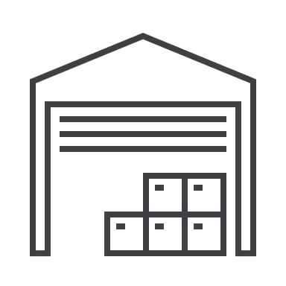
Industrial 3 Zone
What is the Industrial 3 Zone?
The Industrial 3 Zone (I3Z) supports a transition between heavier industrial uses and sensitive locations in other zones. The I3Z encourages some light industrial, larger-scale retailing and other activities that do not affect the safety and amenity of nearby residents.
When is a planning permit usually required?
The following uses and developments may require a permit:
Most new buildings (although some of these qualify for the fast-track VicSmart assessment process)
Many new land uses, including increasing an existing land use
Subdivision
It is suggested to check with your council for a new land use that is different to using the property for light industry. Subdivision generally requires a permit too. A permit may also be triggered by an overlay or particular provision.
What may not need a planning permit?
Some new land uses may be allowed without a permit, including some shops, take away food, minor industry and service stations. These uses generally need to meet conditions to not require a permit.
Internal alterations to buildings are unlikely to need a planning permit nor may an installation of minor supporting infrastructure.
Is anything not allowed in the I3Z?
Most residential uses, cinemas, hospitals, most agriculture, large sports facilities and some shops are not allowed in the I3Z.
What do I need to include in my planning permit application?
If your application is for a new building, an extension to an existing one or other development then the following will generally be required:
Site plans, showing key features of the site and adjoining properties – this may also include consideration of the surrounding area, and a design response
Elevation plans including floor levels, boundary setbacks and designs of the building
Floor plans, detailing setbacks from boundaries, areas of open space and proposed features
If your application is for a land use (or increasing an existing use), then council may need to know about things like:
Traffic movements and car parking layout
Number of staff and opening hours
Layout of the use
Any off-site smell, noise or other impacts
Projected economic benefits
Are there any specific requirements?
In almost all applications, a planning report and other consulting reports should be submitted. The other reports could be:
Traffic and car parking report
Preliminary environmental reports including soil testing or how the site may be remediated
Environmentally sensitive design report
Council may need evidence that nearby residential land will not be affected, especially where a land use needs a planning permit.

Slide 24
Schedule to the XXZ
Use this template to develop local content to better explain particular schedules, especially those that might be common or difficult for home- and business-owner applicants to understand. This template can be replicated numerous times to meet council’s needs.
Relevant icon here
XXXXX City / Shire / Rural City Council
To what areas does this schedule to the XXZ apply?
This schedule – known as the XXZX – applies to the…
Use this section to briefly explain what this area is called and anything that the general public might need to know about the schedule.
Is there a maximum leasable floor area for this schedule?
Use this section to elaborate on the maximum leasable floor area, if required. We recommend two or three sentences to explain the key elements of the objectives. Always use plain English over technical planning language.
Are there overlays that might guide built form or other development in this schedule?
This section might need two paragraphs to explain any overlays that guide new built form in the industrial suite of zones. Keep in mind that detailed content may be better placed in the relevant overlay schedule. Perhaps a link to that page would be suitable.
This doesn’t need to be specific but should elaborate on what a homeowner or interested party might want to know. For example, “the Design and Development Overlay is applied to make sure new buildings are not dominating the surrounds” or “the Merri Creek runs along the eastern part of this area and the Environmental Significance Overlay intends to limit discharge into the creek”.
This section can be used to elaborate on any stubs or key information.
Otherwise, this can be used for an image, plans or other example to add-value to the reader.
For matters in the industrial suite of zones, a schedule example should only be developed where there are frequent questions from community.

Slide 25
Commercial Zones
Clause 34 in local planning schemes
Page 26 – Commercial 1
Page 27 – Commercial 2
Page 28 – Commercial 3

Slide 26
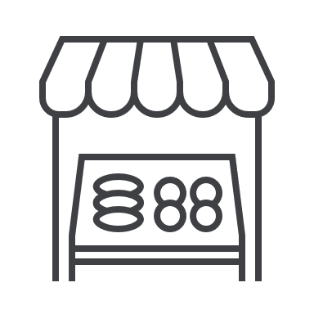
Commercial 1 Zone
What is the Commercial 1 Zone?
The Commercial 1 Zone (C1Z) is most often used for ‘main street’ shopping precincts. The C1Z promotes diverse commercial centres for shopping, office, entertainment and community activities. This zone can encourage residential development above the ground floor of buildings to support the role of the shopping centre.
When is a planning permit usually required?
The following uses typically need a planning permit in the Commercial 1 Zone:
Most new buildings (although minor renovations might qualify for the fast-track VicSmart assessment process)
Many non-commercial land uses
Subdivision
Check with council about any other new land uses that are different to a shop or other commercial premises. A permit may also be triggered by an overlay or particular provision.
What may not need a planning permit?
The following actions may not need a permit:
Many commercial and some residential land uses in existing buildings (although planning scheme conditions generally must be met to avoid a permit)
Internal alterations to buildings
Installation of minor supporting infrastructure
Is anything not allowed in the C1Z?
Some agriculture, large sports facilities and motor racing tracks are not allowed in the C1Z.
What do I need to include in my planning permit application?
If your application is for a new building, an extension to an existing one or other development then the following will generally be required:
Site plans, showing key features of the site and adjoining properties – this may also include a neighbourhood and site description, and design response
Elevation plans including floor levels, boundary setbacks and designs of the building
Floor plans, detailing setbacks from boundaries, areas of open space and proposed features
Any applicable overlays or provisions may require additional information to be shown on the plans.
If your application is for a new land use, council generally need to know about:
Traffic and vehicle movements
Numbers of patrons and hours of operation
Layout of the land use
Additional noise or smell impacts
Types of land uses in the surrounding area (including schools, child care centres, and hospitals)
Are there any specific requirements?
In almost all applications, a planning report and other consulting reports should be submitted. The other reports could be:
Traffic and car parking report
Environmentally sensitive design report
Urban design response
Speak to council to get advice on the information you should include in your application.

Slide 27
Commercial 2 Zone
What is the Commercial 2 Zone?
The Commercial 2 Zone (C2Z) is most often used for offices, larger scale retailing and a broad range of commercial services. The C2Z does not encourage residential development but may be appropriate for light industrial activities.
When is a planning permit usually required?
The following uses typically need a planning permit in the Commercial 2 Zone:
Most new buildings (although minor renovations might qualify for the fast-track VicSmart assessment process)
Many non-commercial land uses
Subdivision
Check with council about any other new land uses that are different to a shop, office or other commercial premises. A permit may also be triggered by an overlay or particular provision.
What may not need a planning permit?
The following actions may not need a permit:
Many commercial and some light industrial land uses in existing buildings (although planning scheme conditions generally must be met to avoid a permit)
Internal alterations to buildings
Installation of minor supporting infrastructure
Is anything not allowed in the C2Z?
Some residential uses, agriculture, hospitals and large sport facilities are not allowed.
What do I need to include in my planning permit application?
If your application is for a new building, an extension to an existing one or another development then the following is usually needed:
Site plans, showing key features of the site and adjoining properties – this may also include a neighbourhood and site description, and design response
Elevation plans including floor levels, boundary setbacks and designs of the building
Floor plans, detailing setbacks from boundaries, areas of open space and proposed features
If your application is for a land use, then council generally need to know about things like:
Traffic and vehicle movements
Numbers of patrons and hours of operation
Layout of the land use
Additional noise or smell impacts
Types of land uses in the surrounding area (including schools, child care centres, and hospitals)
Are there any specific requirements?
In almost all applications, a planning report and other consulting reports should be submitted. The other reports could be:
Traffic and car parking report
Environmentally sensitive design report
Landscape plans
Urban design response
Speak to council to get advice on the information you should include in your application.
.

Slide 28
Commercial 3 Zone
What is the Commercial 3 Zone?
The Commercial 3 Zone (C3Z) is intended to support mixed use employment-focused areas. The C3Z promotes collaborative activities and high-quality urban form. This zone is not yet frequent throughout the state and is located in key pockets of metropolitan Melbourne.
When is a planning permit usually required?
The following uses typically need a planning permit in the Commercial 3 Zone:
Most new buildings, renovations or extensions
Many non-commercial land uses, including those for which the planning scheme condition is not met
Subdivision
Check with council about any other new land uses that are different to a shop or other commercial premises. A permit may also be triggered by an overlay or particular provision.
What may not need a planning permit?
The following actions may not need a permit:
Many commercial and some light industrial land uses in existing buildings (although planning scheme conditions generally must be met to avoid a permit)
Internal alterations to buildings
Installation of minor supporting infrastructure
Is anything not allowed in the C3Z?
Some residential uses and retailing is not allowed. Large scale sports facilities are not allowed either.
What do I need to include in my planning permit application?
If your application is for a new building, an extension to an existing one or other development then the following will generally be required:
Site plans, showing key features of the site and adjoining properties – this may also include a neighbourhood and site description, and design response
Elevation plans including floor levels, boundary setbacks and designs of the building
Floor plans, detailing setbacks from boundaries, areas of open space and proposed features
If your application is for a land use, then council generally need to know about things like:
Traffic and vehicle movements
Numbers of patrons and hours of operation
Layout of the land use
Additional noise or smell impacts
Types of land uses in the surrounding area (including schools, child care centres, and hospitals)
Are there any specific requirements?
In almost all applications, a planning report and other consulting reports should be submitted. The other reports could be:
Traffic and car parking report
Environmentally sensitive design report
Landscape plans
Urban design response
Speak to council to get advice on the information you should include in your application.

Slide 29
Schedule to the XXZ
Use this template to develop local content to better explain particular schedules, especially those that might be common or difficult for home- and business-owner applicants to understand. This template can be replicated numerous times to meet council’s needs.
Relevant icon here
XXXXX City / Shire / Rural City Council
To what areas does this schedule to the XXZ apply?
This schedule – known as the XXZX – applies to the…
Use this section to briefly explain what this area is called and anything that the general public might need to know about the schedule.
Is there a maximum leasable floor area for this schedule?
Use this section to elaborate on the maximum leasable floor area, if required. We recommend two or three sentences to explain the key elements of the objectives. Always use plain English over technical planning language.
Are there overlays that might guide built form or other development in this schedule?
This section might need two paragraphs to explain any overlays that guide new built form in the industrial suite of zones. Keep in mind that detailed content may be better placed in the relevant overlay schedule. Perhaps a link to that page would be suitable.
This doesn’t need to be specific but should elaborate on what a homeowner or interested party might want to know. For example, “the Design and Development Overlay is applied to make sure new buildings are not dominating the surrounds” or “the Merri Creek runs along the eastern part of this area and the Environmental Significance Overlay intends to limit discharge into the creek”.
This section can be used to elaborate on any stubs or key information.
Otherwise, this can be used for an image, plans or other example to add-value to the reader.
For matters in the commercial suite of zones, a schedule example should only be developed where there are frequent questions from community.

Slide 30
Rural Zones
Clause 35 in local planning schemes
Page 21 – Rural Living
Page 22 – Green Wedge
Page 23 – Green Wedge A
Page 24 – Rural Conservation
Page 25 – Farming
Page 26 – Rural Activity

Slide 31
Rural Living Zone
What is the Rural Living Zone?
The Rural Living Zone (RLZ) intends to support residential land in rural parts of Victoria. Small scale agricultural activities (known as ‘hobby farms’) are also often encouraged. RLZ lots are often absent of reticulated sewerage, requiring wastewater to be treated on-site.
When is a planning permit usually required?
The following development types typically need a planning permit in the RLZ:
Larger, more commercial forms of agriculture and their associated buildings
Other allowed commercial activities and their buildings
A new house without all services
Subdivision
A permit may also be triggered by an overlay or particular provision.
What may not need a planning permit?
Many residential and some minor agricultural land uses may be allowed, although planning scheme conditions generally must be met to avoid a permit.
A single house with services connected may not need a permit nor may small and medium sized sheds. Renovations, outdoor structures, fences and other things to do with a house may not need a permit.
Always check if a permit is required under an overlay or particular provision.
Is anything not allowed in the RLZ?
Most industry, offices, some retailing, more intense forms of agriculture, brothels, sawmills, cinemas and car racing are not allowed in the RLZ.
What do I need to include in my planning permit application?
If your application is for a new building (including a new house), an extension to an existing one or other development then the following will generally be required:
Site plans, showing key features of the site – features of adjoining lots close to the boundary, access roads and road reserves should be shown too
Basic elevation plans including floor levels, boundary setbacks and designs of the building are often needed
Floor plans, detailing setbacks from boundaries and layouts may be required
If your application is for a land use in the RLZ, then council generally need to know about things like:
Traffic and vehicle movements
Numbers of patrons and hours of operation
Layout of the land, and how different parts of the land will be used
Additional noise or smell impacts, particularly those which may impact neighbours
Types of land uses in the surrounding area, particularly near Farming Zone land
Are there any specific requirements?
In many applications, a planning report and other consulting reports should be submitted. The other reports could be land capability assessments, details on driveways or others. Speak to council about their requirements.
Many RLZ lots do not include reticulated sewerage. Effluent disposal must be considered in these situations.

Slide 32
Green Wedge Zone
What is the Green Wedge Zone?
The Green Wedge Zone (GWZ) intends to recognise, protect and conserve rural areas on the urban fringe for its character. This means farming activities are generally encouraged in the GWZ as are other sustainable land management activities. It can also mean that non-agricultural development is discouraged.
When is a planning permit usually required?
A planning permit might be needed for the following use and development types in the GWZ:
Most non-agricultural (and more intense agricultural) activities and their buildings
New houses (which may not always be approved) – only one house can be on a lot.
Most subdivisions, although there are restrictions on how small a lot may divided into
New development is generally restricted in the GWZ. A permit may also be triggered by an overlay or particular provision.
What may not need a planning permit?
The following might not require a permit:
Some small-scale farming uses (although planning scheme conditions must be met to avoid a permit)
New buildings or earthworks for a use that does not need a permit
Renovations or small extensions to an existing house.
Always check if a permit is required under an overlay or particular provision.
Is anything not allowed in the GWZ?
Two or more houses, most other forms of residential use, many industries, all offices, most retailing and many other uses are not allowed in the Green Wedge.
What do I need to include in my planning permit application?
If your application is for a new building (including a house), an extension to a current building or another development then the following will generally be required:
Site plans, showing key features of the site – features of adjoining properties close to the boundary, access roads and road reserves should be shown
Elevation plans including floor levels, boundary setbacks and building design
Floor plans, detailing setbacks from boundaries and layouts may be required
If your application is for a land use in the GWZ, the following are needed:
Traffic and vehicle movements
Numbers of patrons and hours of operation
Layout of the land, and how different parts of the land will be used
Additional noise or smell impacts, particularly those which may impact neighbours
Types of land uses in the surrounding area, particularly near residential land
Are there any specific requirements?
In many applications, a planning report and other consulting reports should be submitted. Additional reports could be land capability assessments, vegetation analysis or many others. Most GWZ lots do not include reticulated sewerage – effluent disposal must be considered in these situations.
Planning applications for seemingly minor activities in the GWZ can be difficult, so it is recommended to speak with council before spending too much time or money on an idea.

Slide 33
Green Wedge A Zone
What is the Green Wedge A Zone?
The Green Wedge A Zone (GWAZ) intends to protect, conserve and enhance the rural character on the metropolitan fringe. This means farming activities are generally encouraged in the GWAZ as are other sustainable land management activities. It can also mean that non-agricultural development is discouraged, although existing rural living is protected.
When is a planning permit usually required?
A planning permit might be needed for:
Most non-agricultural (and more intense agricultural) activities and their buildings
New houses (which may not always be approved) – only one house can be on a lot.
Most subdivisions, although there are restrictions on how small a lot may divided into
New development is generally restricted in the GWAZ. A permit may also be triggered by an overlay or particular provision.
What may not need a planning permit?
The following might not require a permit:
Some small-scale farming uses (although planning scheme conditions must be met to avoid a permit)
New buildings or earthworks for a use that does not need a permit
Renovations or small extensions to an existing house.
Always check if a permit is required under an overlay or particular provision.
Is anything not allowed in the GWAZ?
Two or more houses, many other residential uses, many industries, all offices, most retailing and many other uses are not allowed in the Green Wedge A Zone.
What do I need to include in my planning permit application?
If your application is for a new building (including a house), an extension to a current building or another development then the following will generally be required:
Site plans, showing key features of the site – features of adjoining properties close to the boundary, access roads and road reserves should be shown
Elevation plans including floor levels, boundary setbacks and building design
Floor plans, detailing setbacks from boundaries and layouts may be required
If your application is for a land use in the GWAZ, the below will likely be needed:
Traffic and vehicle movements
Numbers of patrons and hours of operation
Layout of the land, and how different parts of the land will be used
Additional noise or smell impacts, particularly those which may impact neighbours
Types of land uses in the surrounding area, particularly near residential land
Are there any specific requirements?
In many applications, a planning report and other consulting reports should be submitted. Additional reports could be land capability assessments, vegetation analysis or many others. Most GWAZ lots do not include reticulated sewerage – effluent disposal must be considered in these situations.
Planning applications for seemingly minor activities in the GWAZ can be difficult, so it is recommended to speak with council before spending too much time or money on an idea.

Slide 34
Rural Conservation Zone
What is the Rural Conservation Zone?
The Rural Conservation Zone (RCZ) seeks to conserve, protect and enhance the natural and rural surrounds. Development is encouraged to consider sustainable land management and the value of rural landscapes to Victorians. The RCZ generally requires new buildings and land uses to be subtle.
When is a planning permit usually required?
Most new land use activities and their buildings require a planning permit in the RCZ. New houses need permits too and may not always be approved – only one house can be on a lot.
Victorian planning rules are restrictive on what can be done in the RCZ. Most subdivisions need a permit, and there are restrictions on how small or large a lot may be divided into.
A permit may also be triggered by an overlay or particular provision.
What may not need a planning permit?
A small number of minor farming activities do not need a planning permit, although planning scheme conditions must be met to avoid a permit. Buildings associated with these minor farming activities may also not need a permit. Renovations or small extensions to an existing house or sheds may avoid a permit.
Always check if a permit is required under an overlay or particular provision.
Is anything not allowed in the RCZ?
Many activities are prohibited in the RCZ: two or more houses, most other residential uses, most industries, offices, most retailing and many other uses are not allowed in the RCZ.
What do I need to include in my planning permit application?
If your application is for a new building (including a house), an extension to a current building or another development then the following will generally be required:
Site plans, showing key features of the site – features of adjoining properties close to the boundary, access roads and road reserves should be shown
Elevation plans including floor levels, boundary setbacks and building design
Floor plans, detailing setbacks from boundaries and layouts may be required
If your application is for a land use in the RCZ, the items below are likely needed:
Traffic and vehicle movements
Numbers of patrons and hours of operation
Layout of the land, and how different parts of the land will be used
Additional noise or smell impacts, particularly those which may impact neighbours.
Types of land uses in the surrounding area, particularly if near natural and rural surrounds
Are there any specific requirements?
In many applications, a planning report and other consulting reports should be submitted. Additional reports could be land capability assessments, vegetation analysis or many others. Most RCZ lots do not include reticulated sewerage – effluent disposal must be considered in these situations.
Planning applications for seemingly minor activities in the RCZ can be difficult, so it is recommended to speak with council or a planning professional before spending too much time or money on an idea.

Slide 35
Farming Zone
What is the Farming Zone?
The Farming Zone (FZ) intends to provide land for agriculture and retain productive farming land. Non-agricultural uses may be discouraged as they could be negative to future farming activities. For example, small lots (<1ha) in the FZ may not receive permission for a new house for this reason.
When is a planning permit usually required?
In the Farming Zone, the following need a permit:
Most new houses on smaller landholdings (often less than 40ha)
More intense forms of agriculture and other rural activities
Industrial sized sheds
Agricultural industrial and commercial activities
Subdivision (some councils may not support subdivision to ‘excise’ off an existing house lot, as this may be negative for nearby farming activities)
A permit may also be triggered by an overlay or particular provision.
What may not need a planning permit?
There are a few ‘exemptions’ to needing a planning permit in the FZ:
Many forms of agriculture (although some must meet the planning scheme conditions)
Some complementary residential uses, including a new house on a large landholding.
Many forms of farming infrastructure – including medium-sized sheds, fences and other supporting buildings (they generally need to be setback from boundaries, waterways and houses on other land)
Always check if a permit is required under an overlay or particular provision.
Is anything not allowed in the FZ?
Larger types of residential use, cinemas, offices, many retail premises and brothels are not allowed.
What do I need to include in my planning permit application?
If the application is for a new building or house, or an extension to a current building or house then the following will usually be needed:
Site plans, showing key features of the site – features of adjoining properties close to the boundary, access roads and road reserves should be shown
Elevation plans including floor levels, boundary setbacks and building / house design
Floor plans, detailing setbacks from boundaries and layouts may be required
If your application is for a land use in the FZ, the items below are likely needed:
Traffic and vehicle movements
Numbers of patrons and hours of operation
Layout of the land, and how different parts of the land will be used
Additional noise or smell impacts, particularly those which may impact neighbours.
Types of land uses in the surrounding area, particularly if near natural and rural surrounds
Are there any specific requirements?
For many applications, a planning report should be submitted. Additional consultant reports could be required including land capability assessments, farm management plans or others. Most FZ lots do not include reticulated sewerage – effluent disposal must be considered in these situations.
Applications for new houses on small landholdings generally must be associated with a new or established farm. Many councils have local policies discouraging houses in FZ unless needed for farming.

Slide 36
Rural Activity Zone
What is the Rural Activity Zone?
The Rural Activity Zone (RAZ) intends to provide land for farming while also supporting other activities to diversify rural economies. An important aspect of the RAZ is making sure that new uses or buildings do not negatively impact on agriculture or other existing land uses. Many RAZ sites have been designated for specific activities by councils.
When is a planning permit usually required?
Most new houses on smaller landholdings require a planning permit in the RAZ. More intense forms of agriculture and tourism activities require a planning permit too. Industrial sized sheds, rural industrial and commercial activities and other items may be permitted but generally require a permit.
Subdivision generally needs a planning permit, and some councils may have rules around the maximum size that a new lot can be.
A permit may also be triggered by an overlay or particular provision.
What may not need a planning permit?
Many forms of agriculture – and some forms of rural commercial / industrial activities – do not need a permit, although some must meet the planning scheme conditions to avoid a planning permission. Some complementary residential uses may also be allowed without a planning permit, including a new house on a large landholding.
Many forms of supporting infrastructure including medium-sized sheds, fences and other buildings may not need planning permission. They generally must be setback from boundaries, waterways and house on other land to avoid planning though.
Always check if a permit is required under an overlay or particular provision.
Is anything not allowed in the RAZ?
Larger types of residential use, child care centres, cinemas, offices, non-rural industry, many retail premises, nightclubs and brothels are not allowed.
What do I need to include in my planning permit application?
If the application is for a new building or house, or an extension to a current building or house then the following will usually be needed:
Site plans, showing key features of the site – features of adjoining properties close to the boundary, access roads and road reserves should be shown
Elevation plans including floor levels, boundary setbacks and building / house design
Floor plans, detailing setbacks from boundaries and layouts may be required
Types of land uses in the surrounding area, particularly if near natural and rural surrounds
If an application is for land use in the RAZ, things like vehicle movements, hours of operation, site layout and impacts on nearby farming activities are often needed. Depending on the new activity proposed, it generally must be considerate of surrounding farming actions.
Are there any specific requirements?
For many applications, a planning report should be submitted. Additional consultant reports could be required although this depends on the activities and buildings proposed. Most RAZ lots do not include reticulated sewerage – effluent disposal must be considered in these situations.
It is recommended to liaise with council’s economic development unit early on, as RAZ land is often designated for particular uses or activities.

Slide 37
Schedule X to the XXZ
Use this template to develop local content to better explain particular schedules, especially those that might be common or difficult for home- and business-owner applicants to understand. This template can be replicated numerous times to meet council’s needs.
Relevant icon here
XXXXX City / Shire / Rural City Council
To what areas does schedule X to the XXZ apply?
This schedule – known as the XXZX – applies to the…
Use this section to briefly explain what this area is called and anything that the general public might need to know about the schedule.
What are the conservation objectives for the XXZX?
Use this section to elaborate on any conservation objectives. We recommend two or three sentences to explain the key elements of the objectives. Always use plain English over technical planning language. Delete this section if not needed.
Are there any specific requirements when assessing applications in the XXZX?
This section might need two paragraphs to explain any variations to minimum subdivision areas, minimum areas for which no permit is required or other items. Consider the types of questions that the planning departments might receive frequently. The answer here does not need to be all encompassing.
This doesn’t need to be specific but should elaborate on what a homeowner or interested party might want to know. For example, “a lot smaller than 40ha requires a planning permit for a new dwelling and that dwelling must be needed for farming” or “the minimum subdivision size is 20ha for a new lot”.
This section can be used to elaborate on any stubs or key information.
Otherwise, this can be used for an image, plans or other example to add-value to the reader.

Slide 38
Public Land Zones
Clause 36 in local planning schemes
Page 28 – Public Land

Slide 39
Public Land Zones
What are Public Land Zones?
Public land zones are generally for land held in public ownership or intended for current or future community activities. There are several zones in this suite, including:
Public Use Zone (PUZ)
Public Park and Recreation Zone (PPRZ)
Public Conservation and Resource Zone (PCRZ)
Transport Zone (TZ)
This page briefly outlines each of the public land zones and when they are generally used.
What is the PUZ and when is it used?
The Public Use Zone is for community services, facilities and public utilities including: service & utility, education, health & community, cemetery / crematorium, local government and other uses. Many public schools, hospitals, council offices and other piece of infrastructure are within the PUZ.
In many circumstances, a land use or building carried out in accordance with the designated public use does not require planning permission in the PUZ. For non-public ownership or activities, or other land uses, interpretations can get murkier and it is recommended to speak to a professional.
What is the PPRZ and when is it used?
The Public Park and Recreation Zone is for areas of recreation and open space. This is a frequent zone for parks, sporting ovals and beach foreshores. Minor non-public commercial uses may be permissible where appropriate.
In some circumstances, a land use or building carried out by or on behalf of the public land manager may not need a planning permit. Activities carried out by other parties usually require a planning permit.
What is the PCRZ and when is it used?
The Public Conservation and Recreation Zone is for protecting and conserving the natural environment and associated processes. This zone is often used for national parks, state forests and similar resource-focused public land uses.
In some circumstances, a land use or building carried out by or on behalf of the public land manager may not need a planning permit. Activities carried out by other parties usually require a planning permit.
What is the TZ and when is it used?
The Transport Zone provides land for Victoria’s transport system, its associated services and facilities, and other activities that complement transportation. This includes: state transport infrastructure (such as rail or minor airports), the principal road network, significant council roads and other transport uses.
If an application is carried out by or on behalf of the relevant transport manager or in association with the designated transport activity, generally a planning permit is not required. However, if a land use or building does not meet this guidance then often a planning permit is required and permission must be sought from the head of the relevant agency.

Slide 40
Special Purpose Zones
Clause 37 in local planning schemes
Page 30 – Land for Special Purposes

Slide 41
Special Purpose Zones
What are Special Purpose Zones?
Special purpose zones apply to land designated or needed for a specific activity. These activities may be significant to the state of Victoria. The zones in this suite include:
Special Use Zone (SUZ)
Comprehensive Development Zone (CDZ)
Urban Floodway Zone (UFZ)
Capital City Zone (CCZ)
Docklands Zone (DZ)
Priority Development Zone (PDZ)
Urban Growth Zone (UGZ)
Activity Centre Zone (ACZ)
Port Zone (PZ)
This page briefly outlines each of the special purpose zones and when they are generally used.
What is the SUZ and when is it used?
The SUZ is to designate land for specific purposes as outlined within the relevant ‘schedule’ to the zone. Check with your council to gauge how this land has been designated, how it is intended to be used or developed.
What is the CDZ and when is it used?
The CDZ designates land within a comprehensive development plan, which outlines the uses and development sought by the council.
What is the UFZ and when is it used?
The UFZ covers waterways, floodpaths, drainage depressions and high flood hazard areas. Due to the high risk to human safety and potential for impacts to floodwater and waterway flows, many activities are not allowed in this zone
What is the CCZ and when is it used?
The CCZ seeks to enhance Melbourne’s central city as the capital of Victoria. The CCZ supports this as an area of national and international significance with specific land uses and guidelines for this important part of the state. The ‘schedules’ to the CCZ impact the types of activities and buildings encouraged.
What is the DZ and when is it used?
The DZ encourages development and dwelling types that respond to the unique location of the Docklands neighbourhood of Melbourne. The ‘schedules’ to the DZ impact the types of activities and buildings encouraged.
What is the PDZ and when is it used?
The PDZ designates land for projects and areas of regional and state significance. A PDZ plan outlines the uses and development sought which must be incorporated within the local planning scheme.
What is the UGZ and when is it used?
The UGZ is for land that is intended to transition from non-urban to urban land. This land is generally on the metropolitan periphery and often requires the preparation of a precinct structure plan to recognise the transition.
What is the ACZ and when is it used?
The ACZ usually encourages ‘intensive development’ around metropolitan and regional city activity centres. The ‘schedule’ to the ACZ generally encourages a mixture of land uses, built forms and layouts.
What is the PZ and when is it used?
The PZ recognises the primacy of the Port of Melbourne as a transport, logistics and maritime gateway to the state. Uses and development that support this are generally encouraged.

Slide 42
XXXXXX XXXXXX Zone
Use this template to develop local content to better explain particular zones, especially those that might be common or difficult for home- and business-owner applicants to understand. This template can be replicated numerous times to meet council’s needs.
Relevant icon here
What is the XXXXX XXXXXXX Zone?
The XXXXXX XXXXXX Zone (XXZ) identifies parts of Victoria where...
Use this section to briefly explain what this overlay is and summarise the purpose in plain English using 2-3 sentences. Use local understanding for explaining this information in simpler language.
When is a planning permit usually required?
Within the XXZ, a planning permit is required for:
Most new buildings or construction not being done as a part of an existing house
Many new land uses…
Use this section to outline common permit triggers – this doesn’t need to be all inclusive but should focus instead on common queries from home- and business-owners, prospective applicants or others. Make use of dot points where possible as they can make items easier to read.
What may not need a planning permit?
There are some actions that do not need a permit within the XXZ, including:
Minor extensions, renovations and building to existing houses…
Use this section to outline the most frequent exemptions to planning permits. This should include the items that council receives frequent enquiries about or don’t necessarily make sense to a lay person. Make use of dot points where possible as they can make items easier to read.
Is anything not allowed in the XXZ?
Use this section to summarise the Section 3 uses within the zone. It is recommended this is in sentence format and land uses are in plain English rather than planning scheme terms (where possible).
What do I need to include in my planning permit application?
This section should outline the specific information required for a planning application triggered under this overlay. We recommend two or three sentences to explain key pieces of information that a homeowner or interested party might want to know.
Are there any specific requirements?
This section should outline the specific application requirements and when they might apply. We recommend two or three sentences to explain key pieces of information that a homeowner or interested party might want to know.

Slide 43
Schedule X to the XXZ
Use this template to develop local content to better explain particular schedules, especially those that might be common or difficult for home- and business-owner applicants to understand. This template can be replicated numerous times to meet council’s needs.
Relevant icon here
XXXXX City / Shire / Rural City Council
To what areas does schedule X to the XXZ apply?
This schedule – known as the XXZX – applies to the…
Use this section to briefly explain what this area is called and anything that the general public might need to know about the schedule.
What are the XXXXX objectives for the XXZX?
Use this section to elaborate on any relevant objectives. We recommend two or three sentences to explain the key elements of the objectives. Always use plain English over technical planning language. Delete this section if not needed.
Are there any specific requirements when assessing applications in the XXZX?
This section might need two paragraphs to explain any variations to minimum subdivision areas, minimum areas for which no permit is required or other items. Consider the types of questions that the planning departments might receive frequently. The answer here does not need to be all encompassing.
This doesn’t need to be specific but should elaborate on what a homeowner or interested party might want to know. For example, “a lot smaller than 40ha requires a planning permit for a new dwelling and that dwelling must be needed for farming” or “the minimum subdivision size is 20ha for a new lot”.
This section can be used to elaborate on any stubs or key information.
Otherwise, this can be used for an image, plans or other example to add-value to the reader.

Slide 44
Chapter 3 Overlays
Purposes, permit applications and processes

Slide 45
Environmental and Landscape Overlays
Clause 42 in local planning schemes
Page 33 – Environmental Significance
Page 34 – Vegetation Protection
Page 35 – Significant Landscape

Slide 46
Environmental Significance Overlay
What is the Environmental Significance Overlay?
The Environmental Significance Overlay (ESO) applies to areas where development need to consider of specific environmental factors. Local ‘schedules’ include statements of environmental significance and any objectives to be achieved. The schedule describes those factors and how they must be considered in an ESO.
When is a planning permit usually required?
A planning permit is required for many development actions including:
Most new buildings
This may include earthworks, removing trees or other vegetation, or installing a new effluent disposal area.
Subdivision generally requires a permit too.
The ESO is designated for areas that are environmentally sensitive, therefore development must consider this.
What may not need a planning permit?
The best way to avoid needing a planning permit in the ESO can be to develop outside the overlay areas, if possible. If your entire land is impacted by an ESO, check the schedule as there may be exemptions, including for fencing, driveways, some new buildings or other minor activities. There is a long list of exemptions in the planning scheme too, so check if your proposal meets any of these.
Is anything not allowed in the ESO?
While no land uses or specific development are ‘prohibited’ in the ESO, some activities may not receive support. Councils require that specific environmental factors are prioritised for new development – if it is has not been appropriately considered, approval may not be issued.
What do I need to include in my planning permit application?
Given the different environmental matters for which an ESO might need a permit, it is recommended to check the schedule and with the council before progressing too far with a proposal. The schedule often includes any information that must be submitted The specific requirements will depend on the significance of the area, therefore different reports, plans and other items may be required for submission.
Are there any specific requirements?
The statement of environmental significance and objectives within a schedule must be responded to and considered. This might need particular reports prepared.
How different are ESO’s based on the local schedule?
The diversity of environmental issues covered in the ESO is outlined by some of the schedules across Victoria. For example:
Western Grassland Reserves – Wyndham City
Biodiversity Habitat Areas and Biolink Corridors – Yarra Ranges Shire
Proclaimed Water Catchment Areas – Moorabool Shire
Shepparton Waste Water Treatment Complex Environmental Significance Area – Greater Shepparton City
South-eastern Black Cockatoo Habitat Areas – Glenelg Shire
Each of these schedules consider unique local environmental issues, showing the need to speak with local authorities before progressing too far.

Slide 47
Schedule X to the ESO
Use this template to develop local content to better explain particular schedules, especially those that might be common or difficult for home- and business-owner applicants to understand. This template can be replicated numerous times to meet council’s needs.
Relevant icon here
XXXXX City / Shire / Rural City Council
To what areas does schedule X to the ESO apply?
This schedule – known as the ESOX – applies to the…
Use this section to briefly explain what this area is called and anything that the general public might need to know about the schedule. The statement of environmental significance can be most helpful for explaining this information in simpler language.
What are the environmental objectives for the ESOX?
Use this section to elaborate on any environmental objectives. We recommend two or three sentences to explain the key elements of the objectives. Always use plain English over technical planning language. Delete this section if not needed.
Are there specific permit requirements for new buildings, land uses or other development in the ESOX?
This section might need two paragraphs to explain any variations to permit triggers including for land uses, buildings with particular areas or other items. Consider the types of questions that the planning departments might receive frequently. The answer here does not need to be all encompassing.
This doesn’t need to be specific but should elaborate on what a homeowner or interested party might want to know. For example, “an application for intensive agriculture requires a planning permit and requires a referral to XXX authority” or “the minimum subdivision size is 2ha for a new lot – this is to limit intensive development in the identified water catchment area”.
Are there any specific application requirements in the ESOX?
This section should outline the specific application requirements and when they might apply. We recommend two or three sentences to explain key pieces of information that a homeowner or interested party might want to know.
Are there any specific decision guidelines in the ESOX?
This section should outline the specific decision guidelines and the implications for any planning applications.
We recommend two paragraphs of two to four sentences to explain key pieces of information that a homeowner or interested party might want to know. Always use plain English over technical planning language

Slide 48
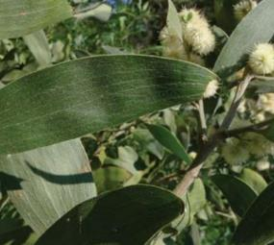
Vegetation Protection Overlay
What is the Vegetation Protection Overlay?
The Vegetation Protection Overlay (VPO) protects significant vegetation and directs development to minimise the loss of existing trees and other vegetation. Local ‘schedules’ include a statement of the vegetation’s significance and any vegetation protection objectives to be achieved. The schedule describes those factors and how they must be considered when decisions are made.
When is a planning permit usually required?
A planning permit is generally required for:
Removing, destroying or lopping any protected vegetation
This might include groundcover vegetation or shrubs, so it is recommended to check the local schedule closely
In some instances, a new building or earthworks within a tree protection zone for protected vegetation may require a planning permit (to make sure the tree’s health may not be negatively impacted)
What may not need a planning permit?
The best way to avoid needing a planning permit in the VPO is to avoid removing vegetation or building within tree protection zones of protected trees or vegetation. Often new buildings or earthworks away from protected trees or other vegetation avoid the need for a planning permit.
There is a list of exemptions within the planning scheme that might avoid the need for a planning permit, as might the local schedule have some exemptions.
Is anything not allowed in the VPO?
While specific development is not ‘prohibited’ in a VPO, approval to remove significant vegetation can be difficult without good reasons. Often councils prefer that the trees and vegetation are retained with new development designed and located accordingly.
What do I need to include in my planning permit application?
Within the VPO, all trees and vegetation must generally be shown on a site plan. Often an arborist report must accompany an application. The specific requirements will depend on the vegetation significance, therefore other reports or plans may be required for submission.
Are there any specific requirements?
The statement of the nature and significance of the vegetation to be protected must be responded to and considered. This might need particular reports prepared
VPO protected Blackwood (Acacia melanoxylon) in Macedon Ranges Shire

Slide 49
Schedule X to the VPO
Use this template to develop local content to better explain particular schedules, especially those that might be common or difficult for home- and business-owner applicants to understand. This template can be replicated numerous times to meet council’s needs.
Relevant icon here
XXXXX City / Shire / Rural City Council
To what areas does schedule X to the VPO apply?
This schedule – known as the VPOX – applies to the…
Use this section to briefly explain what this area is called and anything that the general public might need to know about the schedule. The statement of nature and significance of vegetation to be protected can be most helpful for explaining this information in simpler language.
What are the vegetation protection objectives for the VPOX?
Use this section to elaborate on any vegetation protection objectives. We recommend two or three sentences to explain the key elements of the objectives. Always use plain English over technical planning language. Delete this section if not needed.
Are there any specific application requirements in the VPOX?
This section should outline the specific application requirements and when they might apply. We recommend two or three sentences to explain key pieces of information that a homeowner or interested party might want to know.
Delete this section if not needed.
Are there specific permit requirements for new buildings, land uses or other development in the VPOX?
This section might need two paragraphs to explain any variations to permit triggers or other items. Consider the types of questions that the planning departments might receive frequently. This might also include an permit exemptions that the team has to explain often (i.e., trees that risk immediate danger to health or human safety). The answer here does not need to be all encompassing.
This doesn’t need to be specific but should elaborate on what a homeowner or interested party might want to know. For example, “a permit is required for works within a tree protection zone of a tree with a height greater than 7 metres” or “a permit is required to lop a branch with a diameter greater than 500mm”.
If there are no specific permit requirements then delete this section if not needed.
Are there any specific decision guidelines in the VPOX?
This section should outline the specific decision guidelines and the implications for any planning applications.
We recommend two paragraphs of two to four sentences to explain key pieces of information that a homeowner or interested party might want to know. Always use plain English over technical planning language.
Delete this section if not needed.

Slide 50
Significant Landscape Overlay
What is the Significant Landscape Overlay?
The Significant Landscape Overlay (SLO) identifies – and seeks to conserve and enhance – significant landscapes. Local ‘schedules’ include a statement of the nature, key elements of the landscape and the landscape character objectives. The schedule describes those factors and how they must be considered when a decision is made.
When is a planning permit usually required?
A planning permit is required for:
Most new buildings
This may extend to earthworks, and removing trees or other vegetation
The SLO is designated for areas that have landscapes of local significance, therefore the items that contribute to this – trees, pleasant buildings, open fields, views to the ocean – are generally protected.
What may not need a planning permit?
The best way to avoid needing a planning permit in the SLO can be to develop outside the overlay areas, if possible. If your entire land is impacted by an SLO, check the schedule as there may be exemptions, including for fencing, driveways, some new buildings or other minor activities. There is a long list of exemptions in the planning scheme too, so check if your proposal meets any of these.
Is anything not allowed in the SLO?
While no land uses or specific development are ‘prohibited’ in the SLO, many impactful activities may not receive support. Often councils prefer that the relevant landscape and visual factors are considered for new development – if it is has not been considered, approval may not be issued.
What do I need to include in my planning permit application?
Given the different landscape matters for which an SLO might need a permit, it is recommended to check the schedule and with the council before progressing too far with a proposal. The schedule often includes any information that must be submitted The specific requirements will depend on the significance of the area, therefore different reports, plans and other items may be required for submission.
Are there any specific requirements?
The statement of landscape significance and objectives within a schedule must be responded to and considered. This might need particular reports prepared.
How different are SLO’s based on the local schedule?
The diversity of landscape issues covered in the SLO is outlined by some of the schedules across Victoria. For example:
Yarra (Birrarung) River Corridor Environs – Boroondara City
Neighbourhood Character Areas – Whitehorse City
Approaches to Maldon Landscape Area – Mount Alexander Shire
Great Ocean Road Landscape Area – Corangamite Shire
Mallacoota Inlet and Surrounds – East Gippsland Shire
Each of these schedules consider unique local landscape characteristics which must be considered for new buildings.

Slide 51
Schedule X to the SLO
Use this template to develop local content to better explain particular schedules, especially those that might be common or difficult for home- and business-owner applicants to understand. This template can be replicated numerous times to meet council’s needs.
Relevant icon here
XXXXX City / Shire / Rural City Council
To what areas does schedule X to the SLO apply?
This schedule – known as the SLOX – applies to the…
Use this section to briefly explain what this area is called and anything that the general public might need to know about the schedule. The statement of nature and key elements of landscape can be most helpful for explaining this information in simpler language.
What are the landscape character objectives for the SLOX?
Use this section to elaborate on any landscape protection objectives. We recommend two or three sentences to explain the key elements of the objectives. Always use plain English over technical planning language.
Delete this section if not needed.
Are there any specific application requirements in the SLOX?
This section should outline the specific application requirements and when they might apply. We recommend two or three sentences to explain key pieces of information that a homeowner or interested party might want to know.
Delete this section if not needed.
Are there specific permit requirements for new buildings, land uses or other development in the SLOX?
This section might need two paragraphs to explain any variations to permit triggers including building heights, materials or other items. Consider the types of questions that the planning departments might receive frequently. This might also include an permit exemptions that the team has to explain often. The answer here does not need to be all encompassing.
This doesn’t need to be specific but should elaborate on what a homeowner or interested party might want to know. For example, “a permit is required to remove, destroy or lopping an vegetation native to Australia” or “routine maintenance by a public landowner does not require a planning permit”.
If there are no specific permit requirements then delete this section if not needed.
Are there any specific decision guidelines in the SLOX?
This section should outline the specific decision guidelines and the implications for any planning applications.
We recommend two paragraphs of two to four sentences to explain key pieces of information that a homeowner or interested party might want to know. Always use plain English over technical planning language.
Delete this section if not needed.

Slide 52
Heritage and Built Form Overlays
Clause 43 in local planning schemes
Page 37 – Heritage
Page 38 – Design and Development
Page 39 – Incorporated Plan, Development Plan & Neighbourhood Character

Slide 53
Heritage Overlay
What is the Heritage Overlay?
The Heritage Overlay (HO) identifies places of cultural or natural heritage significance. The HO seeks to preserve these places and enhance the parts of them that have heritage significance. Matters in the HO often focus on seemingly small factors – it is important to closely identify and protect parts of the land. The HO has many permit requirements, as it can be important to make sure new buildings, extensions and other matters protect the heritage character of a place.
When is a planning permit usually required?
Almost all buildings, extensions and other activities require planning permission in the HO. Unlike many other overlays a planning permit is required before demolition and – in some circumstances – painting an exterior, among many other activities.
What may not need a planning permit?
Several minor actions may not require a planning permit, including:
Repairs and routine maintenance to heritage buildings, although it is important that the materials are very similar or the same.
Some trees and fences may be able to be replaced without planning permission – this is noted in the schedule to the HO.
Internal renovations may not require planning permits.
A planning permit is not required for a new land use, although check the zone to see if it is allowed.
Is anything not allowed in the HO?
While no land uses or specific development are ‘prohibited’ in the HO, councils often have specific policies and guidance on how new buildings must look. It is recommended to speak with council about this early – if the local rules have not been considered, approval may not be issued.
What do I need to include in my planning permit application?
As heritage matters are often specific to the particular building or place, it is recommend to liaise with the local planning department. Officers may receive many applications within the HO, so council often arranges a high-quality engagement strategy possibly including speaking with the local heritage advisor. Many councils have heritage policies that outline the requirements for permit applications.
Are there any specific requirements?
Demolition plans are generally required as a part of an application within a HO. The plans for a renovation or extension may require higher levels of detail than might be needed for other types of application. This is where local policies and speaking with council officers can be helpful.
Some councils may include particular application requirements within their planning scheme too.
How different are HO’s based on the individual schedule?
In HO’s, each place’s schedule outlines whether the actions below require additional assessment:
External painting
Internal alterations
Tree removal or lopping
Solar energy systems
The schedules also influence matters like how notice may be given for a proposal, whether a permit is required from a different agency or whether prohibited uses may be allowed.

Slide 54
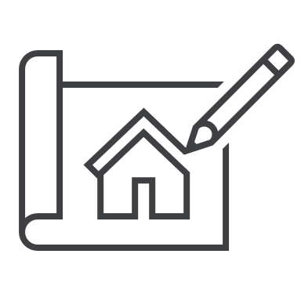
Design and Development Overlay
What is the Design and Development Overlay?
The Design and Development Overlay (DDO) identifies areas where new buildings have requirements relating to their design. Many DDO’s have guidance for the future built form and may guide a transition within an activity centre or other key part of a local community. DDO’s are often used to implement structure plans or other strategic policies from councils. Owing to this, the local schedule is important in understanding a DDO.
When is a planning permit usually required?
As mentioned above, the local schedule is important when reviewing what types of activities require a planning permit. Generally, a new building will require a planning permit, although a local schedule may only require a planning permit if over a specific height. Some local DDO schedules have specific rules for signs, and some types of application may be suitable for a fast-track VicSmart assessment. Most subdivision requires a planning permit too. It is helpful to have an early discuss with council to better understand the DDO.
What may not need a planning permit?
Most land uses that are allowed within the zone, will not need a planning permit in the DDO. Local schedules outline the types of buildings and construction that do not require a planning permit within the DDO.
Is anything not allowed in the DDO?
While no land uses or specific development are ‘prohibited’ in the DDO, councils often have specific policies and guidance on how new buildings must be designed. It is recommended to speak with council about this early – if the local rules have not been considered, approval may not be issued.
What do I need to include in my planning permit application?
Given the different building design matters for which a DDO might need a permit, it is recommended to check the local schedule and with the council before progressing too far with a proposal. The schedule often includes specific information to be submitted.
The specific requirements might depend on the vision for the area, how buildings should be designed and other aspects. Often urban design, sustainability and other reports must be submitted with an application within a DDO.
Are there any specific requirements?
The statement of design objectives within a schedule must be responded to and considered. This might need specific reports prepared.
How different are DDO’s based on the local schedule?
The diversity of design issues covered in the DDO is outlined by some of the schedules across Victoria. For example:
Hospital Emergency Medical Services Helicopter Flight Path Protection – Melbourne City
City Link Exhaust Stack Environs – Yarra City
Dandenong Foothills: Foothills Backdrop and Ridgeline Area – Yarra Ranges Shire
Major Pipeline Infrastructure – Latrobe City
Port Campbell Commercial Precinct – Corangamite Shire
Each of these schedules consider unique local design characteristics to be considered for new buildings.

Slide 55
Schedule X to the DDO
Use this template to develop local content to better explain particular schedules, especially those that might be common or difficult for home- and business-owner applicants to understand. This template can be replicated numerous times to meet council’s needs.
Relevant icon here
XXXXX City / Shire / Rural City Council
To what areas does schedule X to the DDO apply?
This schedule – known as the DDOX – applies to the…
Use this section to briefly explain what this area is called and anything that the general public might need to know about the schedule. Use local understanding for explaining this information in simpler language.
What are the design objectives for the DDOX?
Use this section to elaborate on any design objectives. We recommend two or three sentences to explain the key elements of the objectives. Always use plain English over technical planning language.
Are there specific permit requirements for new buildings, land uses or other development in the DDOX?
This section might need two paragraphs to explain any variations to permit triggers including building heights, materials or other items. This might require an explanation of mandatory / discretionary heights. Consider the types of questions that the planning departments might receive frequently. This might also include an permit exemptions that the team has to explain often. The answer here does not need to be all encompassing.
This doesn’t need to be specific but should elaborate on what a homeowner or interested party might want to know. For example, “ground level works / renovations to an existing store front does not require a planning permit” or “a permit is required for demolition of a building’s façade”.
Are there any specific application requirements in the DDOX?
This section should outline the specific application requirements and when they might apply. We recommend two or three sentences to explain key pieces of information that a homeowner or interested party might want to know.
Delete this section if not needed.
Are there any specific decision guidelines in the DDOX?
This section should outline the specific decision guidelines and the implications for any planning applications.
We recommend two paragraphs of two to four sentences to explain key pieces of information that a homeowner or interested party might want to know. Always use plain English over technical planning language.
Delete this section if not needed.

Slide 56
Built Form Overlays
What are Built Form Overlays?
There are three additional overlays within this suite:
Incorporated Plan Overlay (IPO)
Development Plan Overlay (DPO)
Neighbourhood Character Overlay (NCO)
The IPO / DPO are overlays that require a specific plan to be prepared and approved for the future use and development of an area. This allows for an integrated approach to land use and development planning for larger strategic sites.
The NCO identifies parts of Victoria where the local neighbourhood character is (or is intended to be) unique. New development must be respectful of this character.
The land is covered by a DPO or IPO – what does this mean for building or starting a land use?
The first step will be to determine whether an incorporated plan or development plan has been sufficiently prepared. If the relevant plan is not prepared, a permit generally cannot be granted and no building or new land may be carried out.
If a plan has been prepared, the local council will have access and should share it. New development and land uses within the DPO / IPO area must be ‘generally in accordance’ with the approved plan. This may be complicated to work out, and may require engagement with either local council planners or an independent planning or legal professional.
A land use or development which is contrary to an approved plan will generally not be approved and cannot be carried out.
My land is within an NCO – what does this mean for a renovation?
The planning scheme requirements for houses within an NCO are similar to within a Heritage Overlay (HO).
As NCO matters are often specific to the particular neighbourhood and characteristics of that area, it is recommend to liaise with the local planning department. Many councils have neighbourhood character policies that may outline the requirements for permit applications.
Are there any specific requirements for applications within the NCO?
Demolition plans are generally required as a part of an application within a NCO. The plans for a renovation or extension may require higher levels of detail than might be needed for other types of application. This is where local policies and speaking with council officers can be most helpful.
Some councils may include particular application requirements within their planning scheme too.

Slide 57
Schedule X to the IPO / DPO / NCO
Use this template to develop local content to better explain particular schedules, especially those that might be common or difficult for home- and business-owner applicants to understand. This template can be replicated numerous times to meet council’s needs.
Relevant icon here
XXXXX City / Shire / Rural City Council
To what areas does schedule X to the IPO / DPO / NCO apply?
This schedule – known as the IPO / DPO / NCOX – applies to the…
Use this section to briefly explain what this area is called and anything that the general public might need to know about the schedule. Use local understanding for explaining this information in simpler language.
What are the neighbourhood character objectives for the IPO / DPO / NCOX?
Use this section to elaborate on any neighbourhood character (or other) objectives. We recommend two or three sentences to explain the key elements of the objectives. Always use plain English over technical planning language.
Delete this section if not needed.
Are there any specific application requirements in the IPO / DPO / NCOX?
This section should outline the specific application requirements and when they might apply. We recommend two or three sentences to explain key pieces of information that a homeowner or interested party might want to know.
Delete this section if not needed.
Are there specific permit requirements for new buildings, land uses or other development in the IPO / DPO / NCOX?
This section might need two paragraphs to explain any variations to permit triggers including building heights, designs or other items. Consider the types of questions that the planning departments might receive frequently. This might also include an permit exemptions that the team has to explain often. The answer here does not need to be all encompassing.
This doesn’t need to be specific but should elaborate on what a homeowner or interested party might want to know. For example, “for applications within the development plan area new buildings must follow the layout of the plan” or “a permit is required for demolition of a building’s façade or any other external walls”.
If there are no specific permit requirements then delete this section if not needed.
Are there any specific decision guidelines in the IPO / DPO / NCOX?
This section should outline the specific decision guidelines and the implications for any planning applications.
We recommend two paragraphs of two to four sentences to explain key pieces of information that a homeowner or interested party might want to know. Always use plain English over technical planning language.
Delete this section if not needed.

Slide 58
Land Management Overlays
Clause 44 in local planning schemes
Page 41 – Erosion & Salinity Management
Page 42 – Floodway, Land Subject to Inundation & Special Building
Page 43 – Bushfire Management
Page 44 – State Resource & Buffer Area

Slide 59
Erosion / Salinity Management Overlays
What is the Erosion Management Overlay?
The Erosion Management Overlay (EMO) protects parts of Victoria prone to erosion, landslip or similar matters. Development must minimise land disturbance in these areas and some activities may be inappropriate where land subsidence may occur or cannot be mitigated.
What is the Salinity Management Overlay?
The Salinity Management Overlay (SMO) seeks to protect and rehabilitate parts of the state subject to higher levels of saline ground water discharge. This may be encouraged through revegetation or other stabilising measures.
When is a planning permit usually required?
The following actions generally need a planning permit:
Most new buildings
This may extend to earthworks, removing trees or other vegetation, or installing a new waste water treatment area
Subdivision
What may not need a planning permit?
Both the EMO and SMO have tables of exemptions outlining activities that do not need a planning permit. Check these tables closely, as emergency works, fire protection and noxious weed removal are examples of exempt activities. New land uses within existing buildings may not need a planning permit, although remember to check the zone.
What may not need a planning permit (continued)?
Outside of the tables of exemption, for the EMO, the schedule within the local planning scheme may outline some buildings or earthworks that may not require a planning permit. Otherwise, there are few additional planning permit exemptions.
Some activities within the SMO may not require a planning permit including where an existing building is not being increased in size and there is no increase in waste water discharge. Some agricultural buildings may not require planning permission either.
Are there any specific requirements?
Given the sensitivities of land covered by an EMO or SMO, a planning report and additional consultant reports are generally required. This would be in addition to plans that show details of the proposal, effluent / wastewater areas, areas of cut & fill and other key information as required.
For applications within the EMO, a local schedule may require consulting reports like a geotechnical assessment, land capability assessment or a landslide hazard assessment. This is required to demonstrate that any risks to human health can be reduced to an acceptable level.
For applications within the SMO, technical reports may be required to investigate soil types, impacts from groundwater incursion and how wastewater is to be treated. Depending on the complexity of issues, topography and proposal, additional reports may be needed.
It is recommended to consult with the local council before progressing an idea too far along if the site falls within the EMO or SMO.

Slide 60
Schedule X to the EMO / SMO
Use this template to develop local content to better explain particular schedules, especially those that might be common or difficult for home- and business-owner applicants to understand. This template can be replicated numerous times to meet council’s needs.
Relevant icon here
XXXXX City / Shire / Rural City Council
To what areas does schedule X to the EMO / SMO apply?
This schedule – known as the EMO / SMOX – applies to the…
Use this section to briefly explain what this area is called and anything that the general public might need to know about the schedule. Use local understanding for explaining this information in simpler language.
What are the erosion / salinity management objectives for the EMO / SMOX?
Use this section to elaborate on any erosion / salinity management objectives. We recommend two or three sentences to explain the key elements of the objectives. Always use plain English over technical planning language.
Delete this section if not needed.
Are there any specific application requirements in the EMO / SMOX?
This section should outline the specific application requirements and when they might apply. We recommend two or three sentences to explain key pieces of information that a homeowner or interested party might want to know.
Delete this section if not needed.
Are there specific permit requirements for new buildings, land uses or other development in the EMO / SMOX?
This section might need two paragraphs to explain any variations to permit triggers including wastewater discharge, requirements for cut & fill or other items. Consider the types of questions that the planning departments might receive frequently. This might also include an permit exemptions that the team has to explain often. The answer here does not need to be all encompassing.
This doesn’t need to be specific but should elaborate on what a homeowner or interested party might want to know. For example, “earthworks for a new swimming pool need to include a landslip risk assessment” or “wastewater discharge must be contained within the effluent envelope”.
If there are no specific permit requirements then delete this section if not needed.
Are there any specific decision guidelines in the EMO / SMOX?
This section should outline the specific decision guidelines and the implications for any planning applications.
We recommend two paragraphs of two to four sentences to explain key pieces of information that a homeowner or interested party might want to know. Always use plain English over technical planning language.
Delete this section if not needed.

Slide 61
Floodway (FO) / Land Subject to Inundation (LSIO) / Special Building Overlays (SBO)
What are the flood-related overlays?
These three overlays relate to parts of Victoria that are subject to flooding, flood-related impacts and associated risks to health and human safety. These overlay areas also consider matters like the flow of flood waters during a flooding event and ensuring that water quality is not negatively impacted by new development. Land covered by these overlays may be near rivers, creeks, dams, pipes or other infrastructure subject to flooding.
When is a planning permit typically required within flood-related overlays?
As mentioned, most new buildings and structures will need a planning permit. This may extend to earthworks, low paling fences, many swimming pools, or pergolas. Subdivision generally requires a permit in both the flood related overlays too.
What may not need a planning permit?
Although many types of new development require a planning permit in flooding overlays, there are exemptions for minor buildings or development above the relevant flood-level. This includes items like:
First floor extensions to a house
post-and-wire fencing,
raised decking and
footpaths
A new land use may not require a planning permit if it allowed under the zone.
Is anything not allowed?
While no specific development is ‘prohibited’ in the flood related overlays, it must meet guidelines of the relevant water authorities. For this, speak with council and authorities early – if the local rules are not considered, approval may not be issued.
What do I need to include in my planning permit application?
Different flood related overlays may have particular requirements – some of these relate to possible height of floodwaters in a flooding event. For example:
In the FO, a flood risk report or response to the floodplain development plan must be prepared and submitted with an application. This considers risks relating to inundation, human health, and existing and future use of the land.
In the SBO, existing and proposed floor levels to Australian Height Datum (AHD) must be shown, as must basement levels and entry ramps. This extends to the ground level of new fences, decks or other items.
In the LSIO, there are fewer prescriptive requirements, although local schedules and water authorities may have their own.
Depending on the type of new building proposed additional reports may be required.
Are there any specific requirements?
All of the flood-related overlays contain statements or risk, or flooding / floodway management objectives which must be achieved. These are key considerations for water authorities and local councils when assessing applications for new buildings or other construction. These must generally be responded to when submitting a planning application.

Slide 62
Schedule X to the FO / LSIO / SBO
Use this template to develop local content to better explain particular schedules, especially those that might be common or difficult for home- and business-owner applicants to understand. This template can be replicated numerous times to meet council’s needs.
Relevant icon here
XXXXX City / Shire / Rural City Council
To what areas does schedule X to the FO / LSIO / SBO apply?
This schedule – known as the FO / LSIO / SBOX – applies to the…
Use this section to briefly explain what this area is called and anything that the general public might need to know about the schedule. Use local understanding for explaining this information in simpler language.
What are the floodway / land subject to inundation / flooding management objectives for the FO / LSIO / SBOX?
Use this section to elaborate on any relevant management objectives. We recommend two or three sentences to explain the key elements of the objectives. Always use plain English over technical planning language.
Delete this section if not needed.
Are there any specific application requirements in the FO / LSIO / SBOX?
This section should outline the specific application requirements and when they might apply. We recommend two or three sentences to explain key pieces of information that a homeowner or interested party might want to know.
Delete this section if not needed.
Are there specific permit requirements for new buildings, land uses or other development in the FO / LSIO / SBOX?
This section might need two paragraphs to explain any variations to permit triggers including FFL requirements, land use prohibitions or other items. Consider the types of questions that the planning departments might receive frequently. This might also include an permit exemptions that the team has to explain often. The answer here does not need to be all encompassing.
This doesn’t need to be specific but should elaborate on what a homeowner or interested party might want to know. For example, “a new front fence requires a planning permit unless it has 25% openings and a plinth at least 300mm above the relevant flood level” or “the finished floor level must be shown on all relevant floor plans including elevations and ground level drawings”.
If there are no specific permit requirements then delete this section if not needed.
Are there any specific decision guidelines in the FO / LSIO / SBOX?
This section should outline the specific decision guidelines and the implications for any planning applications.
We recommend two paragraphs of two to four sentences to explain key pieces of information that a homeowner or interested party might want to know. Always use plain English over technical planning language.
Delete this section if not needed.

Slide 63
Bushfire Management Overlay
What is the Bushfire Management Overlay?
The Bushfire Management Overlay (BMO) identifies parts of Victoria where bushfire risk requires protection measures. Within BMO areas, the protection of human life and community resilience to bushfire emergencies is a primary consideration for new development and land use. The risk to life and property must be reduced to an acceptable level before approval is granted.
When is a planning permit usually required?
Within the BMO, a planning permit is required for:
Most new buildings or construction not being done as a part of an existing house
Many new land uses – including education, industrial, offices, some community uses, retailing and warehouse
Subdivision – with requirements to consider areas of defendable space and bushfire defence to limit risk during a bushfire
What may not need a planning permit?
There are some actions that do not need a permit within the BMO, including:
Minor extensions, renovations and building to existing houses
Removing trees and vegetation close to an existing house may also be allowed, but be sure to check with the local council before starting the work
Some land uses do not need a planning permit within the BMO, although be sure to check the zone first to make sure there is no requirement within that.
What do I need to include in my planning permit application?
Applications within a BMO likely need specialist input including the preparation of a Bushfire Management Statement. New buildings often require a standard of construction that meets a Bushfire Attack Level measure. This might require the use of non-flammable materials in the new building.
Other technical reports that might be needed include a Bushfire Hazard Site or Landscape assessment.
Owing to these complexities, it is recommended to engage a professional to review a proposal before submitting an application to the local council. As the BMO considerations are broad and require certainty that life and property will be protected, items like bushfire shelters, water tanks and defendable space may support approval.
The CFA website has example templates to support planning applications. For smaller-scale applications, this may allow an application to be submitted without the need for specialist input.
Are there any specific requirements?
The CFA will review and make recommendations for planning applications. This might include needing additional information or plans, conditions for future development or refusing to approve a proposal where human life or property will not be adequately protected. Local councils will often defer to the CFA’s technical knowledge.

Slide 64
Schedule X to the BMO
Use this template to develop local content to better explain particular schedules, especially those that might be common or difficult for home- and business-owner applicants to understand. This template can be replicated numerous times to meet council’s needs.
Relevant icon here
XXXXX City / Shire / Rural City Council
To what areas does schedule X to the BMO apply?
This schedule – known as the BMOX – applies to the…
Use this section to briefly explain what this area is called and anything that the general public might need to know about the schedule. Use local understanding for explaining this information in simpler language.
What are the bushfire management objectives for the BMOX?
Use this section to elaborate on any bushfire management objectives. We recommend two or three sentences to explain the key elements of the objectives. Always use plain English over technical planning language.
Delete this section if not needed.
Are there any specific application requirements in the BMOX?
This section should outline the specific application requirements and when they might apply. We recommend two or three sentences to explain key pieces of information that a homeowner or interested party might want to know.
Delete this section if not needed.
Are there specific permit requirements for new buildings, land uses or other development in the BMOX?
This section might need two paragraphs to explain any variations to permit triggers including building heights, materials or other items. Consider the types of questions that the planning departments might receive frequently. This might also include an permit exemptions that the team has to explain often. The answer here does not need to be all encompassing.
This doesn’t need to be specific but should elaborate on what a homeowner or interested party might want to know. For example, “all new dwellings within the BMOX are required to be constructed to a standard of BAL-12.5 or higher” or “given the risk to safety and property in this area, additional protection measures are recommended”.
If there are no specific permit requirements then delete this section if not needed.
Are there any specific decision guidelines in the BMOX?
This section should outline the specific decision guidelines and the implications for any planning applications.
We recommend two paragraphs of two to four sentences to explain key pieces of information that a homeowner or interested party might want to know. Always use plain English over technical planning language.
Delete this section if not needed.

Slide 65
State Resource & Buffer Area Overlays
What is the State Resource Overlay?
The State Resource Overlay (SRO) protects parts of Victoria where extraction of materials is considered of state significance. The SRO intends to protect these resources from incursion of sensitive activities that may prejudice the ongoing operation or future expansion – this is known as “reverse amenity impact” protection.
What is the Buffer Area Overlay?
The Buffer Area Overlay (BAO) outlines areas where there may be off-site impacts to health, safety or amenity. These impacts may be noise, dust, odour or hazardous air pollutants. The BAO seeks to minimise land use conflicts between sensitive land uses and uses with adverse amenity potential that are otherwise important services to Victorians.
What are the planning requirements within the SRO / BAO?
Within the SRO and BAO, the local planning scheme schedules detail the relevant requirements, including the land uses, development, subdivisions and other activities that may require a planning permit. The specific application requirements are also outlined within the schedule.
It is recommended to speak with the local council around the reverse amenity measures and protections in place for SRO and BAO locations. These might include requirements for new development and some sensitive uses may not be allowed.

Slide 66
Schedule X to the SRO / BAO
Use this template to develop local content to better explain particular schedules, especially those that might be common or difficult for home- and business-owner applicants to understand. This template can be replicated numerous times to meet council’s needs.
Relevant icon here
XXXXX City / Shire / Rural City Council
To what areas does schedule X to the SRO / BAO apply?
This schedule – known as the SRO / BAOX – applies to the…
Use this section to briefly explain what this area is called and anything that the general public might need to know about the schedule. Use local understanding for explaining this information in simpler language.
What are the risks / resource significance for the SRO / BAOX?
Use this section to elaborate on any relevant considerations including risks or resource significance. We recommend two or three sentences to explain the key elements of the objectives. Always use plain English over technical planning language.
Delete this section if not needed.
Are there specific permit requirements for new buildings, land uses or other development in the SRO / BAOX?
This section might need two paragraphs to explain any variations to permit triggers including building heights, materials or other items. Consider the types of questions that the planning departments might receive frequently. This might also include an permit exemptions that the team has to explain often. The answer here does not need to be all encompassing.
This doesn’t need to be specific but should elaborate on what a homeowner or interested party might want to know.
If there are no specific permit requirements then delete this section if not needed.
Are there any specific application requirements in the SRO / BAOX?
This section should outline the specific application requirements and when they might apply. We recommend two or three sentences to explain key pieces of information that a homeowner or interested party might want to know.
Delete this section if not needed.
Are there any specific decision guidelines in the SRO / BAOX?
This section should outline the specific decision guidelines and the implications for any planning applications.
We recommend two paragraphs of two to four sentences to explain key pieces of information that a homeowner or interested party might want to know. Always use plain English over technical planning language.
Delete this section if not needed.

Slide 67
Other Overlays
Clause 45 in local planning schemes
Pages 46-47 – Other Overlays: Key Information

Slide 68
Other Overlays: Key Information
What are Other Overlays?
The overlays within this category are generally designated for special purposes or needs for land. The overlays within this suite include:
Public Acquisition Overlay (PAO)
Airport Environs Overlays (AEO)
Environmental Audit Overlays (EAO)
Road Closure Overlay (RXO)
Restructure Overlay (RO)
Development Contributions Plan Overlay (DCPO)
City Link Project Overlay (CLPO)
Melbourne Airport Environs Overlay (MAEO)
Parking Overlay (PO)
Infrastructure Contributions (Plan) Overlay (ICPO / ICO)
Specific Controls Overlay (SCO)
This page briefly outlines each of the ‘other overlays’ and when they are generally used.
What is the PAO?
The Public Acquisition Overlay identifies land which may be acquired by a designated Minister or authority for a public purpose. The PAO seeks to ensure that changes to that land will not prejudice the purpose for the future public acquisition. Most land uses and construction activities require a planning permit within the parts of land covered by a PAO.
What is the AEO?
The Airport Environs Overlay identifies land near airports that may be subject to aircraft noise and other impacts. Land within the AEO must be compatible with the operation of airports and some land uses sensitive to aircraft noise may be restricted. New buildings may require noise attenuation measures in some circumstances.
What is the EAO?
The Environmental Audit Overlay ensures that potentially contaminated land is remediated prior to a sensitive land use starting on the land. EAO sites may have once contained activities that could have resulted in contamination within the soil and a certificate of environmental audit must generally be achieved if a planning permit is granted.
What is the RXO?
The Road Closure Overlay identifies roads that will be closed by a future change to the planning scheme. Once the road is closed, it will be published in the Government Gazette.
What is the RO?
The Restructure Overlay identifies old and inappropriate subdivisions to be restructured. The RO is generally found in regional Victoria and is focused on preserving existing amenity and reducing environmental impacts that may occur if an area was developed. Often, for new houses or other buildings, a condition – such as consolidating several lots – must be met first.
What is the DCPO?
The Development Contributions Plan Overlay identifies areas where contributions may be required for works, services or facilities. The DCPO generally requires a financial contribution for some activities prior to development starting.
What is the CLPO?
The City Link Project Overlay seeks to ensure the continuing operation and maintenance of infrastructure associated with the City Link Project.

Slide 69
Other Overlays: Key Information
What is the MAEO?
The Melbourne Airport Environs Overlay identifies land near Melbourne Airport that must be compatible with the relevant strategies and master plan. Land within the MAEO must allow for safe air navigation for aircraft arriving or departing. Some land uses sensitive to aircraft noise may be restricted. New buildings may require noise attenuation measures in some circumstances.
What is the PO?
The Parking Overlay identifies areas that may have specific needs relating to car parking. Local car parking rates may be required to facilitate an appropriate provision of car parking spaces. In some areas, financial contributions may be required for shared car parking.
What is the ICO / ICPO?
The Infrastructure Contributions (Plan) Overlay identifies areas where a contributions plan is required for the provision of specific infrastructure.
What is the SCO?
The Special Controls Overlay seeks to deliver a particular land use and development outcome in extraordinary circumstances. This might be for a project of state or regional significance. A specific control must be contained within an incorporated document and may allow (or not allow) particular land uses and development. The SCO may also exclude other controls within a local planning scheme.

Slide 70
XXXXXX XXXXXX Overlay
Use this template to develop local content to better explain particular overlays, especially those that might be common or difficult for home- and business-owner applicants to understand. This template can be replicated numerous times to meet council’s needs.
Relevant icon here
What is the XXXXX XXXXXXX Overlay?
The XXXXXX XXXXXX Overlay (XXO) identifies parts of Victoria where...
Use this section to briefly explain what this overlay is and summarise the purpose in plain English using 2-3 sentences. Use local understanding for explaining this information in simpler language.
When is a planning permit usually required?
Within the XXO, a planning permit is required for:
Most new buildings or construction not being done as a part of an existing house
Many new land uses…
Use this section to outline common permit triggers – this doesn’t need to be all inclusive but should focus instead on common queries from home- and business-owners, prospective applicants or others. Make use of dot points where possible as they can make items easier to read.
What may not need a planning permit?
There are some actions that do not need a permit within the XXO, including:
Minor extensions, renovations and building to existing houses…
Use this section to outline the most frequent exemptions to planning permits. This should include the items that council receives frequent enquiries about or don’t necessarily make sense to a lay person. Make use of dot points where possible as they can make items easier to read.
Is anything not allowed in the XXO?
Use this section to summarise anything that might be explicitly prohibited within the overlay. If nothing, using a general sentence is recommended such as “While no specific development is ‘prohibited’ in the XXXXXX XXXXXX overlay, it must meet guidelines of the relevant XXXXXX authorities. For this, speak with council and authorities early – if the local rules are not considered, approval may not be issued.” This should ensure that unique ideas are directed to council or referral authorities after this document is read.
What do I need to include in my planning permit application?
This section should outline the specific information required for a planning application triggered under this overlay. We recommend two or three sentences to explain key pieces of information that a homeowner or interested party might want to know.
Are there any specific requirements?
This section should outline the specific application requirements and when they might apply. We recommend two or three sentences to explain key pieces of information that a homeowner or interested party might want to know.

Slide 71
Schedule X to the XXXO
Use this template to develop local content to better explain particular schedules, especially those that might be common or difficult for home- and business-owner applicants to understand. This template can be replicated numerous times to meet council’s needs.
Relevant icon here
XXXXX City / Shire / Rural City Council
To what areas does schedule X to the XXXO apply?
This schedule – known as the XXXOX – applies to the…
Use this section to briefly explain what this area is called and anything that the general public might need to know about the schedule. Use local understanding for explaining this information in simpler language.
What are the relevant objectives for the XXXOX?
Use this section to elaborate on any relevant objectives. We recommend two or three sentences to explain the key elements of the objectives. Always use plain English over technical planning language.
Delete this section if not needed.
Are there specific permit requirements for new buildings, land uses or other development in the XXXOX?
This section might need two paragraphs to explain any variations to permit triggers including building heights, materials or other items. Consider the types of questions that the planning departments might receive frequently. This might also include an permit exemptions that the team has to explain often. The answer here does not need to be all encompassing.
This doesn’t need to be specific but should elaborate on what a homeowner or interested party might want to know.
If there are no specific permit requirements then delete this section if not needed.
Are there any specific application requirements in the XXXOX?
This section should outline the specific application requirements and when they might apply. We recommend two or three sentences to explain key pieces of information that a homeowner or interested party might want to know.
Delete this section if not needed.
Are there any specific decision guidelines in the XXXOX?
This section should outline the specific decision guidelines and the implications for any planning applications.
We recommend two paragraphs of two to four sentences to explain key pieces of information that a homeowner or interested party might want to know. Always use plain English over technical planning language.
Delete this section if not needed.

Slide 72
Chapter 4 Glossary and supporting material

Slide 73
Glossary of common planning terms
Access / Accessway (Driveway)
The path used to approach the road from within a property. It refers to what is within the site only, not on the road reserve.
Building Envelope
Shows the outline where buildings can be built, including the setbacks to the property boundaries and the maximum area of a building footprint.
Bushfire Management Overlay (BMO) – see page XX of this guide for more info
Applies to land that might be significantly affected by bushfire. The BMO triggers the need for a Planning Permit for certain uses, developments and subdivisions, and requires appropriate bushfire protection measures.
The CFA and Department of Environment, Land, Water and Planning have a variety of useful resources for anyone developing in an area subject to BMO.
Caveat
A claim from any given party to an interest in the land. Caveats are listed on the Certificate of Title. Example of reasons of a caveat include an easement, or a mortgage being held on the property.
You can purchase a Certificate of Title from the Landata website.
Consolidation
The joining together of two or more lots to make a single larger lot.
Copy of Plan (Title Plan)
A document that shows the subdivision of an original parcel of land, including legal boundaries and location of the parcel/s. It includes a diagram of the property.
You can purchase a Title Plan from the Landata website.
Copy of the Title
The copy of the 'original' title held in the Land Registry. This includes information relating to who owns a piece of land and any mortgages, covenants, caveats or easements affecting the land.
You can purchase a Copy of the Title from the Landata website.
Disclaimer: This glossary is intended to support new permit applicants and should not be used instead of the planning scheme terms at Clause 73 of the XXXXX Planning Scheme. Where there are slight differences in terminology, we recommend deferring to the planning scheme definitions.

Slide 74
Glossary of common planning terms
Crossover
The connection from the edge of a property to the road. This might cross the footpath, nature strip or kerb.
More information on the considerations for new access to a property or creating a new crossover can be found on the Department of Transport website.
Cultural Heritage Management Plan (CHMP)
A written report that includes an assessment of the potential impact of a proposed activity on Aboriginal cultural heritage.
First Peoples – State Relations, has useful resources on preparing a CHMP.
Dwelling
Refers to a building that is capable of being used as a self-contained residence (including kitchen, bathroom, and sanitary facilities). Also known as a house.
Easement
A right attached to a particular piece of land allowing for a specific use of that land. An easement may also mean there are restrictions on the use of that piece of land.
For example, a utility company may be allowed use of the land for pipes or power infrastructure, and you may not be able to build on that portion of the land. Easements are recorded on each property’s Certificate of Title.
You can purchase a Certificate of Title using the Landata website.
Effluent Disposal Area
The area dedicated to the treatment and discharge of wastewater. This is normally a septic tank or leach drain.
Elevations (Elevation Plan)
An image that shows the sides, including dimensions, of a building, sign, or structure. Elevation Plans should include dimensions and orientation, with each side labelled as the north, south, east, or west facing side.
Disclaimer: This glossary is intended to support new permit applicants and should not be used instead of the planning scheme terms at Clause 73 of the XXXXX Planning Scheme. Where there are slight differences in terminology, we recommend deferring to the planning scheme definitions.

Slide 75
Glossary of common planning terms
Endorsed Plans (Approved Plans)
Plans that have been ‘stamped’ or approved by the Responsible Authority (normally Council) and are part of a Planning Permit. Any development must be carried out in accordance with these plans.
Environmental Significance Overlay (ESO) – see page XX of this guide for more info
The ESO triggers the need for a planning permit for certain uses, developments, and subdivision, and requires consideration of ways to minimise the impact of development on the environment.
Exemptions
If particular criteria is met, some proposals may be exempt.
For example: Siting of a shed close to a waterway or road reserve may trigger the requirement for a Planning Permit. If the proposed site of the shed can be moved, this might result in exemption from the requirement for a permit.
Farming Zone – see page XX of this guide for more info
A zone intended to be used for agricultural purposes. Aims to ensure ongoing protection of productive farmland and that non-agricultural uses do not detract from that purpose.
Industrial Zone – see page XX of this guide for more info
A zone intended to be used for the manufacturing industry and the storage and distribution of goods.
Landscape Plan
A plan drawn to scale showing the proposed site design. As well as the boundaries, structures, paths, and driveways. It should include all current and proposed vegetation (including names), a planting schedule of proposed vegetation, quantities, and sizes at maturity.
Lot (Allotment)
Land that can be sold separately without being subdivided.
Native Vegetation
Includes vegetation indigenous to the region including, although not limited to, trees, shrubs, and grasses.
Disclaimer: This glossary is intended to support new permit applicants and should not be used instead of the planning scheme terms at Clause 73 of the XXXXX Planning Scheme. Where there are slight differences in terminology, we recommend deferring to the planning scheme definitions.

Slide 76
Glossary of common planning terms
Native Vegetation Offset
Aims to balance the impact of removing native vegetation. This offset might include protecting, increasing the amount, or paying to have native vegetation planted elsewhere.
More information on securing an offset can be found on the Department of Transport and Planning website.
Overlay – see chapter 3 of this guide for more info
An additional control on land. Aimed at controlling developments related to and potentially affected by flooding, bushfire, heritage, or environmental significance. The overlay on land will impact how the Responsible Authority will assess a Planning Permit application and any conditions placed on the permit.
Planning Consultant Planning professionals that can be engaged by applicants to assist with preparing a Planning Permit application.
Planning Permit
A legal document that allows a certain use and/or development of land.
Planning Scheme
Controls land use and development within a local government area. Contains state and local planning policies, zones, overlays, and other provisions that affect how land can be used, developed, and protected.
For more information relating to planning schemes in general, visit the Department of Transport and Planning website – Schemes and amendments (planning.vic.gov.au)
Potable Water
Water that has been treated to meet Australian guidelines for safe drinking water.
Road Reserve
The area of land set aside for potential road construction. It might include nature strips, roads and unused land and is generally fenceline to fenceline.
Disclaimer: This glossary is intended to support new permit applicants and should not be used instead of the planning scheme terms at Clause 73 of the XXXXX Planning Scheme. Where there are slight differences in terminology, we recommend deferring to the planning scheme definitions.

Slide 77
Glossary of common planning terms
Referral Authority (Referrals)
An internal department of Council or an external authority who provides specialised comments relating to flooding, traffic, animal welfare, or electricity. For example, the Planning department may seek specialised advice from the engineering department of Council, from the Department of Transport, or the CFA.
Responsible Authority
The decision-maker on Planning Permit applications, normally a Council.
Request for Further Information (RFI)
A Responsible Authority seeking more information from an applicant before they can make their assessment to grant a Planning Permit. Common requests include a copy of an up-to-date Title (3 months old or less), fully completed application including development cost, or a more detailed site plan.
Reticulated Water Supply
Piped water.
Rural Living Zone – see page XX of this guide for more info
A zone intended to provide residential use in a rural environment and for agricultural uses, which do not adversely affect the amenity of surrounding land.
Secondary Consent
Permission from the Responsible Authority allowing for minor changes to the endorsed plans to be made, after a Permit has been granted. Secondary consent requests cannot change the wording or conditions of the Permit. An example of changes sought under secondary consent might include amendments to the landscaping or a change to the colour of an external wall.
Section 173 Agreement
A legal contract between Council and another party that determines what can or cannot be done on any piece of land. A Section 173 Agreement can be recorded on the Title of the land and applied to future owners and occupiers of the land.
Setbacks
The horizontal distance from a boundary or building.
Disclaimer: This glossary is intended to support new permit applicants and should not be used instead of the planning scheme terms at Clause 73 of the XXXXX Planning Scheme. Where there are slight differences in terminology, we recommend deferring to the planning scheme definitions.

Slide 78
Glossary of common planning terms
Site Plan
A birds-eye view of the site. A site plan may include details of existing and proposed property boundaries, buildings, vegetation, driveways and roads. Site plans should also include dimensions and orientations and may include annotations. Insufficient site plans are one of the most common reasons Responsible Authorities request further information, therefore ensuring they are detailed is important.
Subdivision
The process of dividing a property into smaller lots that can be sold separately or, the realignment or altering of title boundaries.
Title
An official record of who owns a piece of land. Can also include information relating to mortgages, covenants, caveats and easements affecting the land.
You can purchase a Copy of Title from the Landata website.
Title Search (Search Statement)
Shows the information held by the Victorian Register of Land at the time the search is conducted. Includes the registered proprietors’ names and addresses, mortgage details and information about other encumbrances affecting the land.
You can purchase a Title Search from the Landata website.
Township Zone – see page XX of this guide for more info
A zone intended to be used for residential development, and a range of commercial, industrial and other uses in small towns.
Trafficable width
A sufficiently wide road, accessway or crossover, appropriate for emergency vehicle access.
Transport Zone (TZ)
Land zoned for transport such as roads and railways to provide for the use and development of land that complements, or is consistent with, the transport system.. Zone 1 includes major transport infrastructure and Zone 2 includes the roads in the principal road network, including declared arterial roads.
Disclaimer: This glossary is intended to support new permit applicants and should not be used instead of the planning scheme terms at Clause 73 of the XXXXX Planning Scheme. Where there are slight differences in terminology, we recommend deferring to the planning scheme definitions.

Slide 79
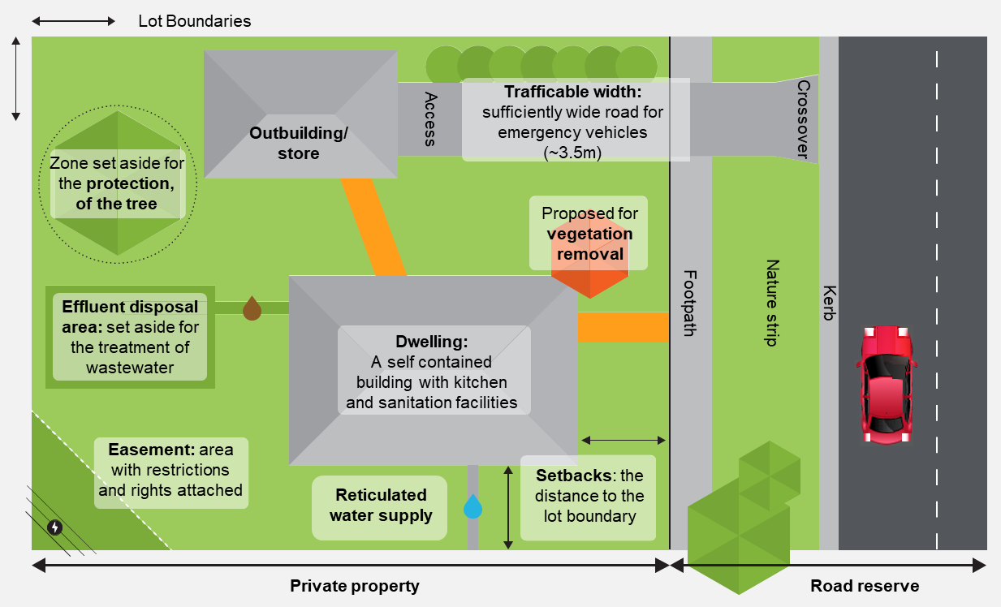
Glossary of common planning terms
Tree Protection Zone (TPZ)
The three-dimensional extent of the space a tree occupies above and below ground, that is set aside for the protection of the tree.
Victorian Civil and Administrative Tribunal (VCAT)
The body that resolves disputes and makes decisions relating to Planning Permit applications and objections. You have a right to appeal to VCAT if you feel a Planning decision is misguided.
Zone
States how the land can be developed or built on and details what is prohibited.
Visual Glossary of Common Planning Terms
`
Disclaimer: This glossary is intended to support new permit applicants and should not be used instead of the planning scheme terms at Clause 73 of the XXXXX Planning Scheme. Where there are slight differences in terminology, we recommend deferring to the planning scheme definitions.

Slide 80
Typical Planning Permit Application Process

Slide 81
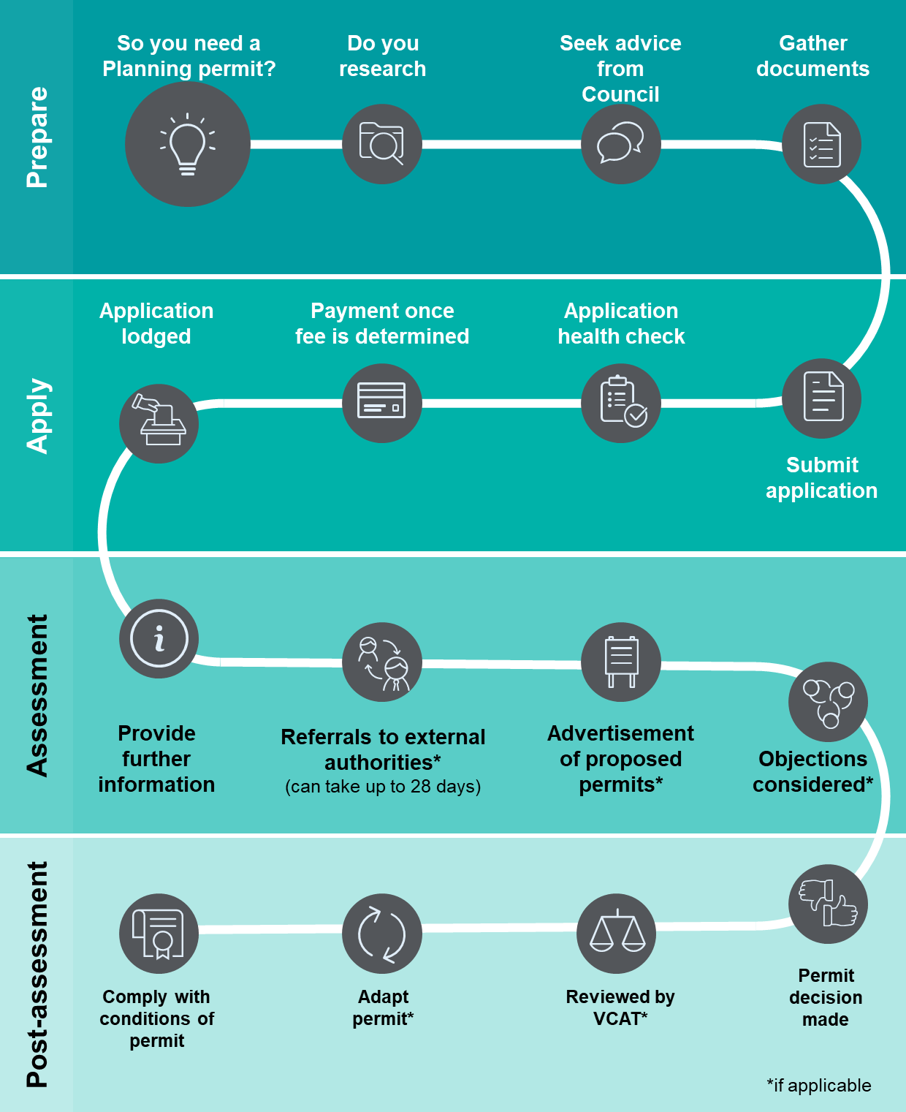
Typical planning permit application process
Notes:
Diagram of typical permit planning application process: State 1 Prepare: So you need a planning permit? Do your research, seek advice from Council, gather documents. Stage 2 apply: submit application, application health check, payment once fee is determined, lodge application. Stage 3: assessment: provide further information, referrals to external authorities (if applicable, and can take up to 28 days), advertisement of proposed permits (if applicable), objections considered (if applicable). Stage 4: Post-assessment: permit decision made, reviewed by VCAT (if applicable), adapt permit (if applicable), comply with conditions of permit.

Slide 82
Planning permit application process
There are several steps involved when applying for a planning permit. Find out how to prepare and submit your application, how we assess your application and how to appeal a decision.
Some steps may not be relevant to your application.
Do your due diligence
Doing your due diligence will help you identify key information, reduce timeframes, and avoid costs or hurdles that may appear during or after the planning permit process.
The following steps will help you find the information you need to start your planning permit application:
Visit VicPlan [insert link] to create a planning property report. The planning property report will identify the zones and overlays that apply to your site.
The zones and overlays will tell you:
What you can and can’t do on the site.
What information is required for an application.
The guidelines used to make planning decisions.
Review the [insert local government name] Planning Scheme [insert link] and identify any relevant policies that apply to your site and the proposed use. This will also help you understand what information is required for an application and what we need to consider when making planning decisions.
Obtain a certificate of title from Landata [insert link]. The certificate of title will identify any covenants, encumbrances or easements that may restrict or impact your proposal. You will need to pay small fee to obtain the title.
When ordering the title, make sure you include the:
Register Search Statement.
Certificate of title.
Any instruments identified as s173 agreements, covenants, encumbrances or easements. You do not need to order mortgage instruments.
A step by step guide to obtaining a certificate of title is found here [INSERT LINK TO TITLE VIDEO].
You may wish to contact non-Council referral authorities once you have the above information. For example, we suggest you contact Melbourne Water for pre-development advice:
To identify the flood level if your site is in a Special Building Overlay or Land Subject to Inundation Overlay.
To identify any development restrictions if you have a drainage easement running through your site.

Slide 83
Planning permit application process
2. Book a pre-application meeting
We recommend you obtain pre-application advice before applying for a planning permit. This could include a phone call or visit to our planning counter, or a formal pre-application meeting [update to reflect services provided at your council].
In the pre-application meeting, we will:
Discuss if your application meets the requirements of the [insert local government name] Planning Scheme [insert link].
Discuss key issues with your proposal.
Explain the application process.
Provide advice on what information you will need to support your application.
We will require a concept plan of your proposal to review and discuss at the meeting. To avoid delays, we strongly recommend you submit the plan at the time of booking.
Book a pre-application meeting using the form below or call XX to speak to the Statutory Planning Department.
[insert the available booking options as relevant]
3. Prepare your application
A well-prepared application will help you to avoid delays and the likelihood of having to update your application later in the process. Use the information given at the pre-application meeting and available on council’s website to help you prepare your application [insert relevant website links].
You can also engage professional planning consultants, building designers/architects, traffic engineers, environmentally sustainable design engineers, and other technical specialists to prepare your planning permit application.

Slide 84
Planning permit application process
4. Submit your application
Your planning permit application must include the following information:
A complete and signed planning permit application form [if form is not auto populated through application portal].
A complete copy of the Certificate of Title no older than 3 months, including any restrictions such as a Section 173 agreements, covenants, encumbrances or easements. You can obtain a Certificate of Title from the Landata website [insert link].
Payment for the relevant application fee [insert payment methods offered].
Plans and elevations for your proposed development that are drawn to scale, have dimensions and show the details of all buildings or other proposed structures, or
Plans showing the proposed use (if development is not proposed).
Written reports to support your application.
A Metropolitan Planning Levy certificate if your development cost exceeds the threshold. Refer to the State Revenue Office website [insert link] to determine if this levy applies to your application.
Refer to [insert relevant website links] to help you prepare a complete planning permit application.
5. Initial assessment
We will start the planning assessment and may arrange an inspection of the property. If we find that your application is missing information, we will send you a written request for further information (RFI).
We may include preliminary concerns or issues with your application in the RFI letter. You will have the opportunity to update your application accordingly. You should address any problems at this stage, or your application may not be supported. We recommend speaking to us before submitting any changes.
You can amend your application at any time during the planning permit application process, however this will incur additional fees and delays if it is done after the public notice stage, so we recommend you respond to any preliminary concerns at the RFI stage.
If we have sufficient information, we will refer your application to:
Internal Council departments to review any technical or strategic aspects of the proposal
External referral authorities if this is triggered

Slide 85
Planning permit application process
6. Providing us with further information
You must provide additional information before the date listed on your Request for Further Information letter. We will not progress your application until the requested information is received.
If you can't get us the information in time
If you're unable to send us information before the lapse date listed on the letter, you will need to request an extension and explain the reasons for the delay. This request must be made at least one day before the RFI lapse date. If we accept your request, we will notify you of the new due date. If we do not accept your request, you will be given 14 days to submit all outstanding information.
If you miss the due date and have not requested an extension, your application will lapse. This means you will have to submit a new planning permit application and pay the fee again.
7. Public notice
We may need to place your application on public notice if there is a chance that the proposal will impact surrounding properties. Your proposal will determine where and how your application is notified.
Public notice may include:
Putting a Notice of an Application for a Planning Permit on the land, usually for at least 14 days.
Sending a letter to next-door property owners and occupiers.
Putting a Notice of an Application for a Planning Permit in the local newspaper.
Council undertakes the public notice process and will charge fees. Some applications will not require public notice. Council does not have the discretion to give notice if an exemption applies.
8. Objections and submissions
When your application is publicly advertised, residents and property owners may view plans attached to your proposal and submit an objection if they feel it may affect them or their property.
A submission can be made at any time before we make a decision and will be considered during our assessment.
If you would like to view plans attached to an application, make a submission or learn more about the process, visit our public notice page [insert link].

Slide 86
Planning permit application process
9. Respond to public notice
You will be provided with a copy of any submissions received when the public notice period is finished. This is your opportunity to make changes to the proposal and address any concerns that have been raised.
We may arrange a consultation meeting with interested parties. The meeting will provide a forum for parties to discuss the proposal, identify and address any concerns and explore opportunities to improve outcomes for all participants [update to reflect your council’s post-public notice processes].
You are encouraged to resolve issues before a decision is made. Any objector has the right to appeal Council’s decision to the Victorian Civil and Administrative Tribunal (VCAT).
Amending your application
You can apply to amend a planning permit application at any time before a decision has been by the Responsible Authority. An additional fee (usually 40% of the original application fee) will apply if you amend your application after public notice. Your application must include details of your proposed amendment, including changes to plans or documents submitted with your original application. We recommend that you only amend your application after public notice if you have spoken to your council planner and have a clear understanding of any council or community concerns.
10. Decision
Planning officers have authority from Council to consider most planning permit applications. Some types of applications are required to be reported to Council for a decision. This may delay our decision by three to four weeks.
There are three types of decisions we can make based on your application. We can:
Issue a Permit (if there are no objections).
Issue a Notice of Decision to Grant a Permit (if objections have been received but Council considers that the proposal is acceptable).
Refuse to Grant a Permit.
Your planning permit is likely to contain conditions that set out how development or a particular use of a parcel of land must proceed and continue. Use and developments can only begin and continue if all conditions on the permit are met.
After your permit has been issued, you can apply to amend any plans, conditions, development or use included in your permit. You can also request an extension of time. Visit our Amend or extend a planning permit page for more information.

Slide 87
VCAT Appeals
Appeal a decision
If you disagree with a decision we have made about a planning permit application, you can appeal it with the Victorian Civil and Administrative Tribunal (VCAT).
The following options are available:
If you are the applicant and want to appeal, you must submit an application to VCAT within 60 days of our decision.
If you are the objector to the application and want to appeal, you must submit an application to VCAT within 28 days of our decision.
When VCAT reviews one of our decisions, it will consider the entire application.
You can find information on how to apply to VCAT on your:
Refusal to Grant a Planning Permit
Notice of Decision to Grant a Planning Permit
Appeals can sometimes be a lengthy process. You will need to wait for a hearing date before the matter can be heard in full by a tribunal member. Depending on the caseload of VCAT at the time, this can sometimes take months.
Any party who has made a submission to an application will be notified of an appeal. Notified parties can make a further submission to the tribunal and decide to attend the hearing. Hearings can vary in length depending on the nature of the case, as well as the number of parties who wish to address the tribunal.
VCAT decisions
When a VCAT hearing ends, VCAT will consider all of the material on file and presented at the hearing. Once a decision is made, a copy of the Tribunal’s order will be sent to all parties by email or mail. This will usually include reasons for the decision.
The Tribunal’s decision is final unless there is an appeal by a party to the Supreme Court on a point of law. If a planning permit is granted, Council must issue that permit in accordance with VCAT's order. We are responsible for making sure the requirements of the permit are met.

Slide 88
Endorsing plans
Submitting plans to be endorsed
When do plans need to be endorsed?
You may need to submit updated plans for endorsement as a condition of a planning permit before a use or development can commence. This can include:
Amended development plans (commonly referred to as “Condition 1 Plans”, in reference to the requirements of condition 1 of a Planning Permit.)
Landscape plans
Tree protection management plans
Construction management plans
Other management plans for ongoing requirements once a development is complete (such as a bushfire management plan, waste management plan – refer to conditions of your planning permit for further advice)
Check the wording of all planning permit conditions carefully. The conditions will state if need you to take a certain action or submit information.
You must not start building works or the use of the land until Council endorses all plans and documents.
Council will only approve amendments that the planning permit conditions require. If you need to make other changes to your plans, contact Council to discuss how to proceed.
What happens next?
Once we receive plans, your endorsement request will be allocated to a planning officer, who will review the plans. Endorsed plans will either be sent to the applicant, or advice will be provided requiring further changes to be made if plans do not sufficiently respond to conditions of the permit.
If changes to plans have been made beyond the scope of the conditions of the Permit, we may direct you to Amend a planning permit.
More information
View Frequently Asked Questions [insert link] or visit our Planning forms, fact sheets and checklists [insert link] page for more information on planning permit applications.
For general planning advice, contact our office on [insert phone number] or visit us at [insert address]. A planning officer is available Monday to Friday to assist you. [update to reflect Council’s business hours and preferred methods of contact]

Slide 89
Example plans for planning applications

Slide 90
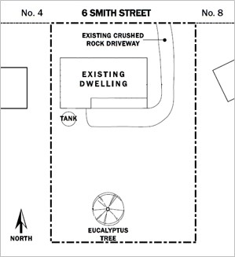
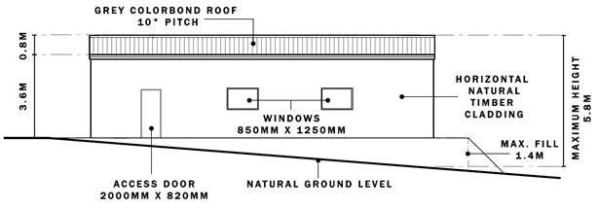
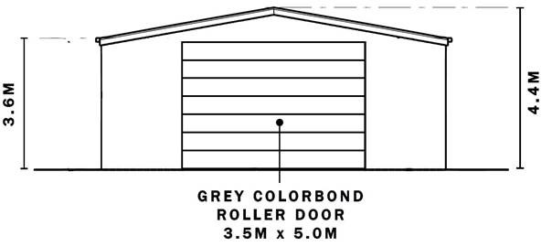
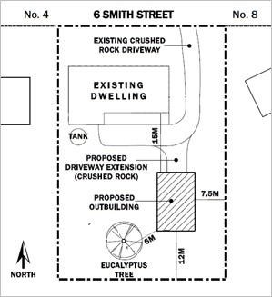
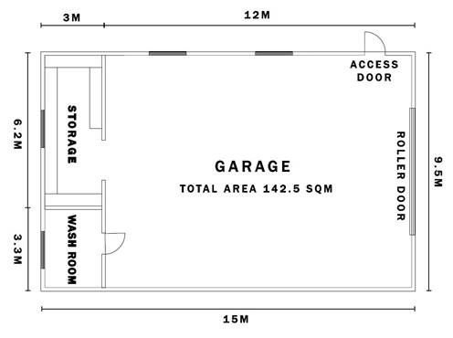
Example plans for new outbuilding (garage) requiring a planning permit
Site plan – existing
Elevation plans - proposed
Site plan – proposed
Floorplan for new garage

Slide 91
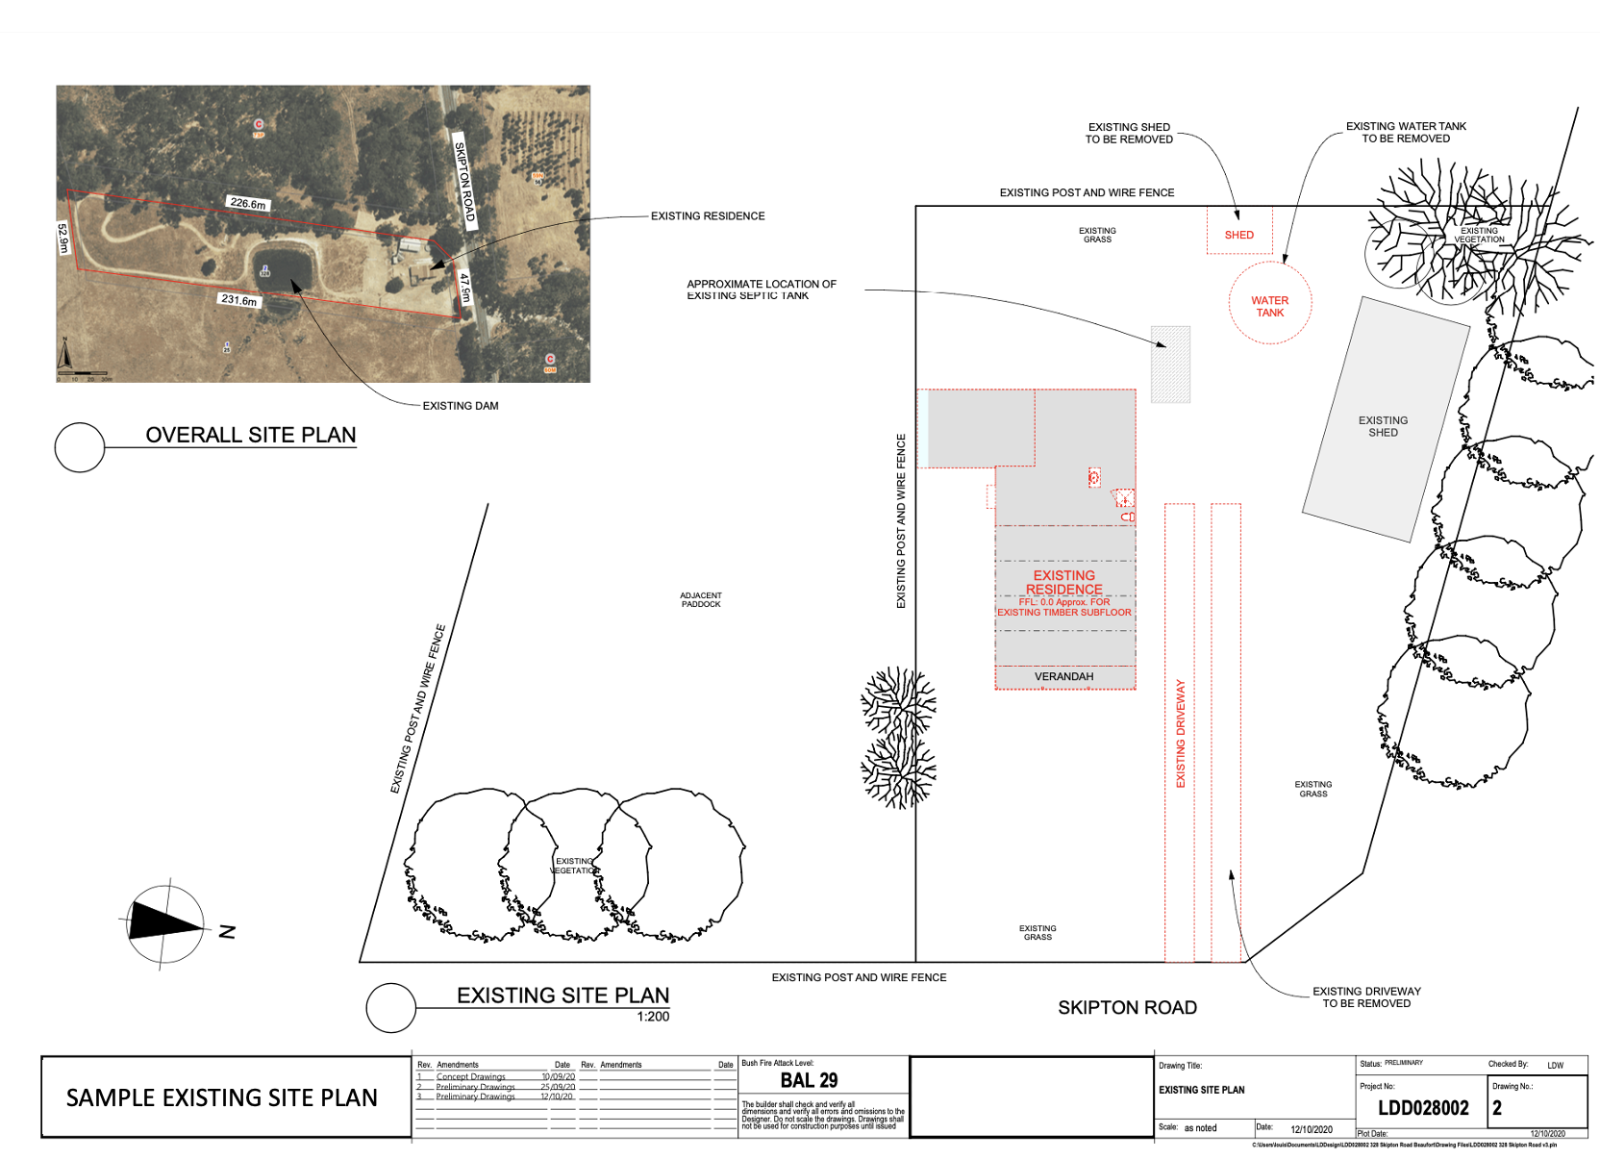
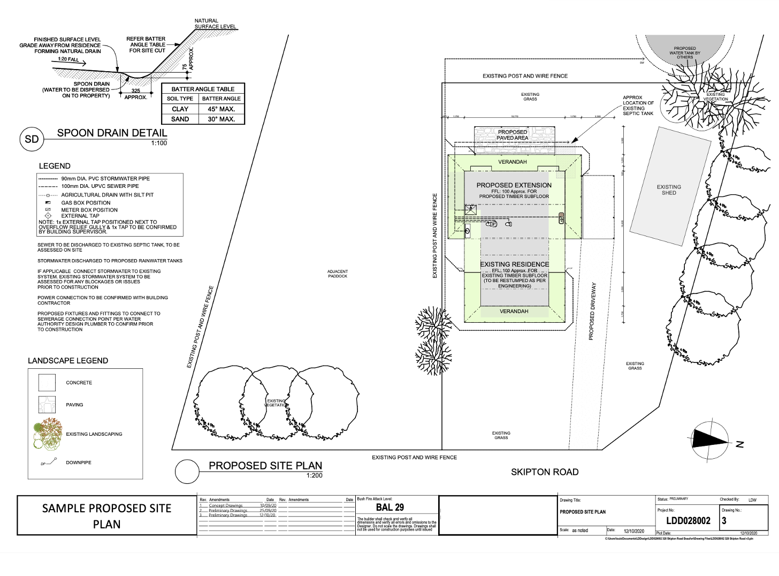
Example plans for a replacement dwelling in the Farming Zone requiring a planning permit
Site plan – existing
Site plan – proposed

Slide 92
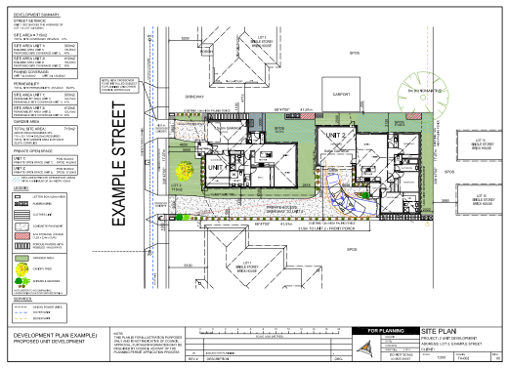
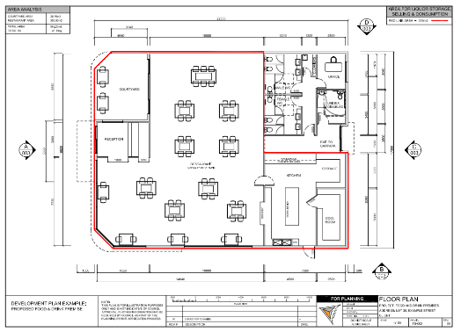
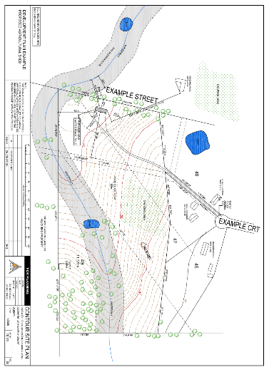
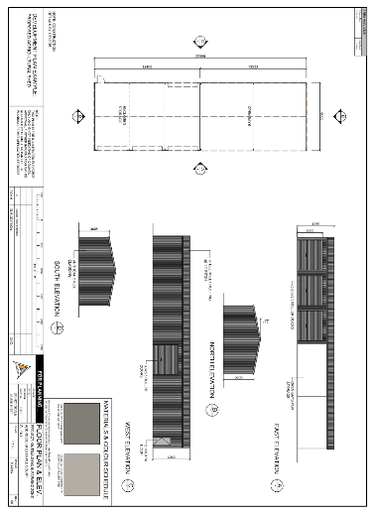
Various example plans
Example site plans - existing and proposed
Example floorplan – red line plan
Example site and contour plan
Example floorplans and elevations

